Slide 1
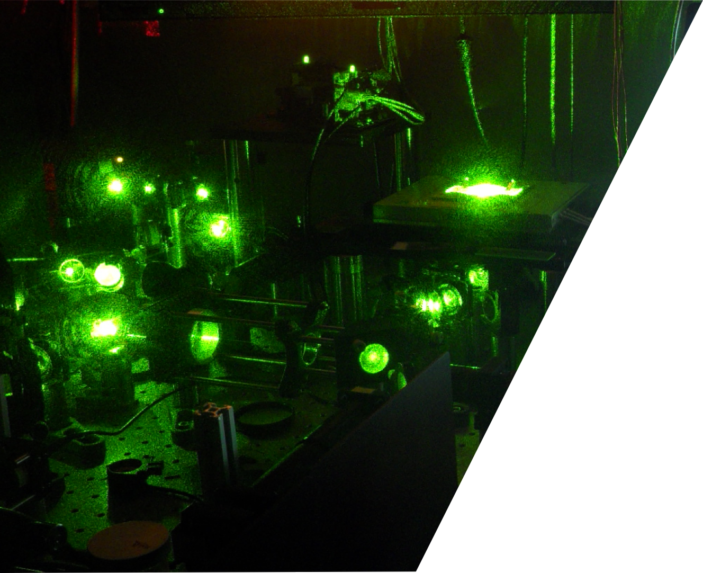


Time-Resolved STED Microscopy
Giuseppe Vicidomini giuseppe.vicidomini@iit.it
@VicidominiLab
Molecular Microscopy and Spectroscopy Istituto Italiano di Tecnologia, Genoa
IIT, Genoa, Italy
6 December 2019
Photo: Paolo Bianchini

Slide 2
Introduction

Slide 3
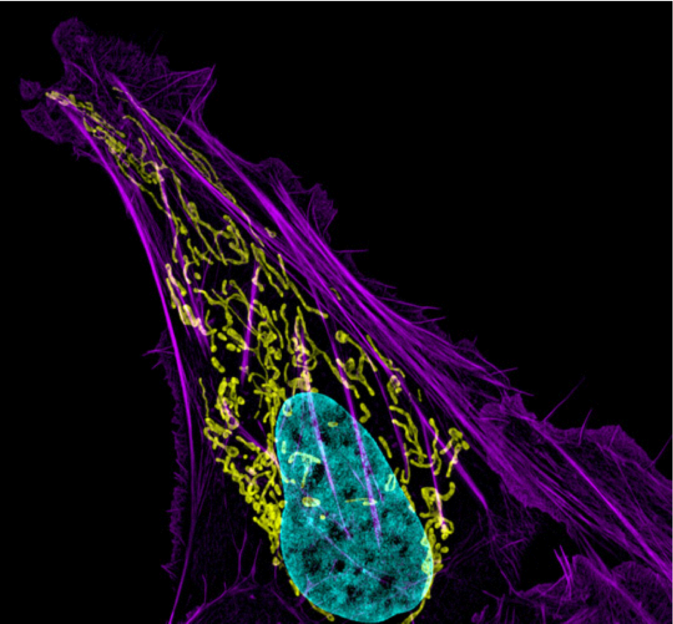
Fluorescence Microscopy
“…..Browse through any cell biological journal, and the impact of fluorescent microscopy is obvious, with > 80% of the images of cells in the book usually acquired with a fluorescent microscope……“
B. Houng et al. Cell 143:1047-1058 (2010)
3RD PLACE, 2012 PHOTOMICROGRAPHY COMPETITION
Dr. Dylan T. Burnette, National Institutes of Health (NIH),Bethesda, Maryland, USA
Human bone cancer (osteosarcoma) showing actin filaments (purple), mitochondria (yellow), and DNA (blue).
3
Notes:
You may be surprise to know that more than 80% of the images of cell in a biological journal or book have been acquired using a fluorescent microscope.

Slide 4

Fluorescence Microscopy
“…..Browse through any cell biological journal, and the impact of fluorescent microscopy is obvious, with > 80% of the images of cells in the book usually acquired with a fluorescent microscope……“
B. Houng et al. Cell 143:1047-1058 (2010)
non-invasive
3RD PLACE, 2012 PHOTOMICROGRAPHY COMPETITION
Dr. Dylan T. Burnette, National Institutes of Health (NIH),Bethesda, Maryland, USA
Human bone cancer (osteosarcoma) showing actin filaments (purple), mitochondria (yellow), and DNA (blue).
L. Schermelleh et al. JCB 190(2): 165-175 (2010)
4
Notes:
This great success stems from the unique characteristics offered by fluorescente microscopy.
Probably the most important is the possibility to make imaging in the physiological conditions for the sample

Slide 5
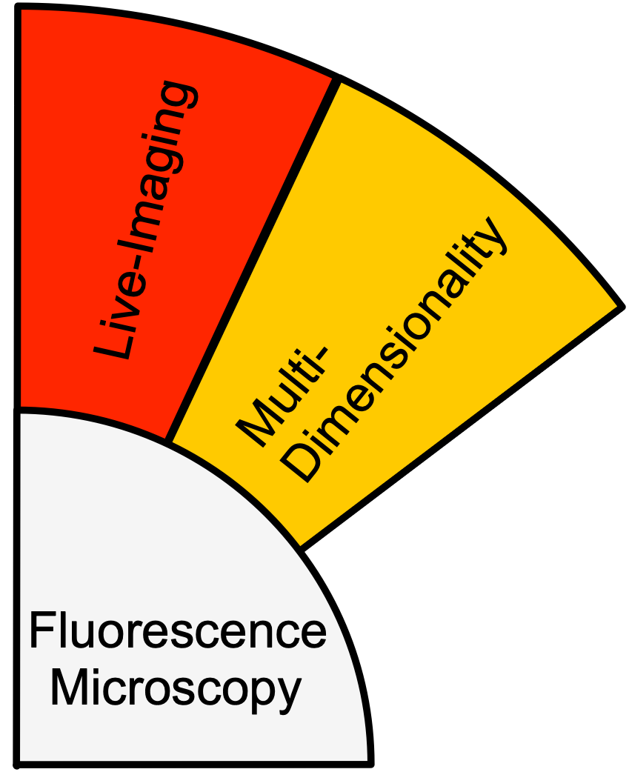
Fluorescence Microscopy
“…..Browse through any cell biological journal, and the impact of fluorescent microscopy is obvious, with > 80% of the images of cells in the book usually acquired with a fluorescent microscope……“
B. Houng et al. Cell 143:1047-1058 (2010)
non-invasive
three-dimensional (x,y,z)
multi-color (𝜆)
time-series (t)
3RD PLACE, 2012 PHOTOMICROGRAPHY COMPETITION
Dr. Dylan T. Burnette, National Institutes of Health (NIH),Bethesda, Maryland, USA
Human bone cancer (osteosarcoma) showing actin filaments (purple), mitochondria (yellow), and DNA (blue).
L. Schermelleh et al. JCB 190(2): 165-175 (2010)
5

Slide 6
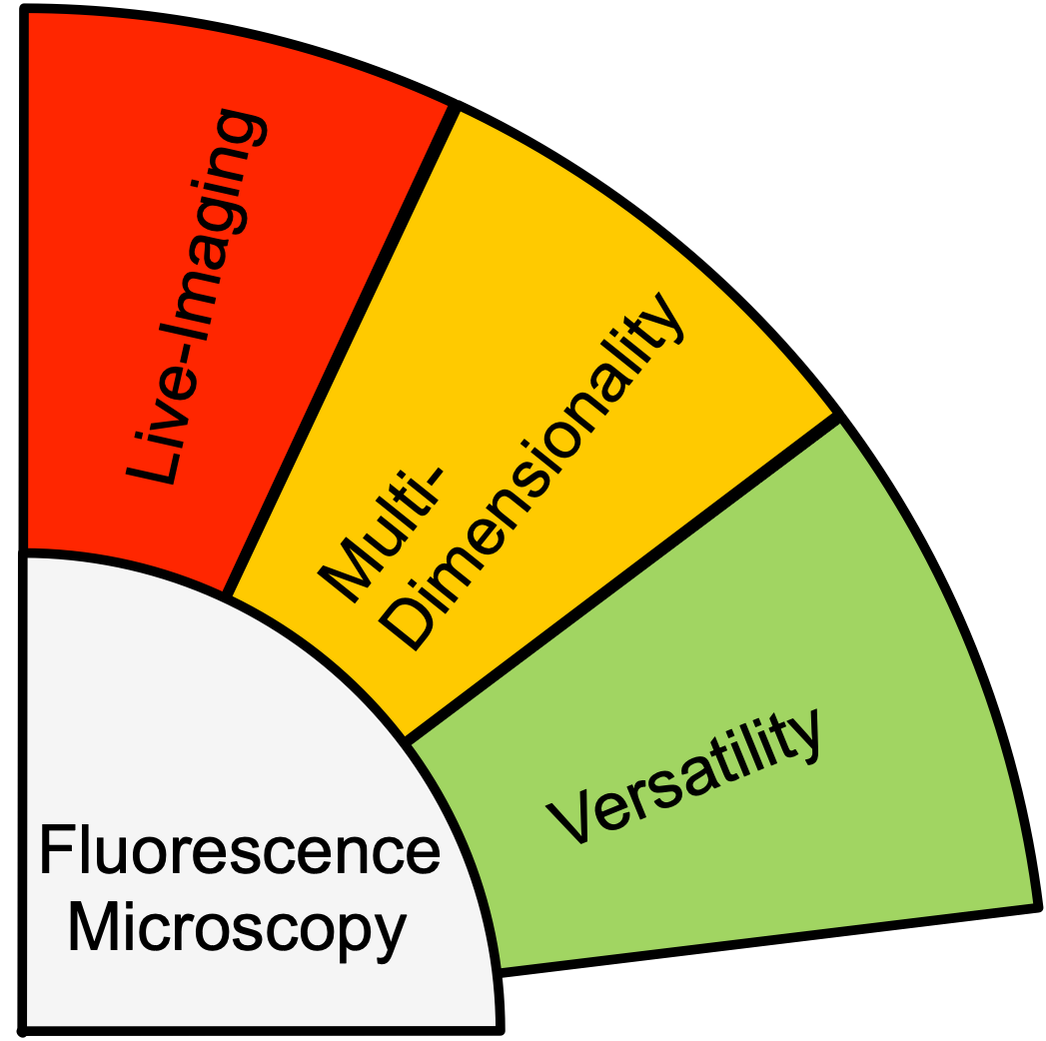
Fluorescence Microscopy
“…..Browse through any cell biological journal, and the impact of fluorescent microscopy is obvious, with > 80% of the images of cells in the book usually acquired with a fluorescent microscope……“
B. Houng et al. Cell 143:1047-1058 (2010)
non-invasive
three-dimensional (x,y,z)
multi-color (𝜆)
time-series (t)
system complexity
sample preparation
artefact free
3RD PLACE, 2012 PHOTOMICROGRAPHY COMPETITION
Dr. Dylan T. Burnette, National Institutes of Health (NIH),Bethesda, Maryland, USA
Human bone cancer (osteosarcoma) showing actin filaments (purple), mitochondria (yellow), and DNA (blue).
L. Schermelleh et al. JCB 190(2): 165-175 (2010)
6

Slide 7
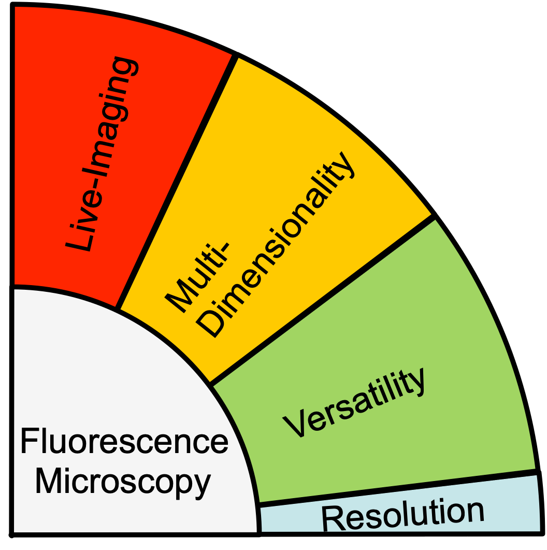
Fluorescence Microscopy
“…..Browse through any cell biological journal, and the impact of fluorescent microscopy is obvious, with > 80% of the images of cells in the book usually acquired with a fluorescent microscope……“
B. Houng et al. Cell 143:1047-1058 (2010)
non-invasive
three-dimensional (x,y,z)
multi-color (𝜆)
time-series (t)
system complexity
sample preparation
artefact free
spatial resolution
3RD PLACE, 2012 PHOTOMICROGRAPHY COMPETITION
Dr. Dylan T. Burnette, National Institutes of Health (NIH),Bethesda, Maryland, USA
Human bone cancer (osteosarcoma) showing actin filaments (purple), mitochondria (yellow), and DNA (blue).
L. Schermelleh et al. JCB 190(2): 165-175 (2010)
7
Notes:
Finally, conventional fluorescent microscopy provides a

Slide 8
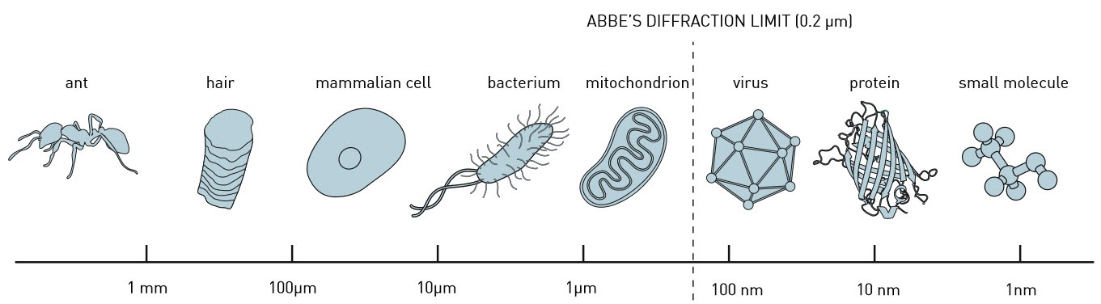
Diffraction Barrier
Illustration: © Johan Jarnestad
The Royal Swedish Academy of Sciences
Electron Microscopy
Fluorescence Microscopy
Naked Eye
8

Slide 9


Diffraction Barrier
Illustration: © Johan Jarnestad
The Royal Swedish Academy of Sciences
Electron Microscopy
Super-Resolved Fluorescence Microscopy (or Nanoscopy)
Naked Eye
9
Notes:
Among all the super-resolved microscope STED microscopy, invented in 1994 from Prof. Stefan Hell, from a initial scepticism is nowadays gaining a substantial momentum.

Slide 10
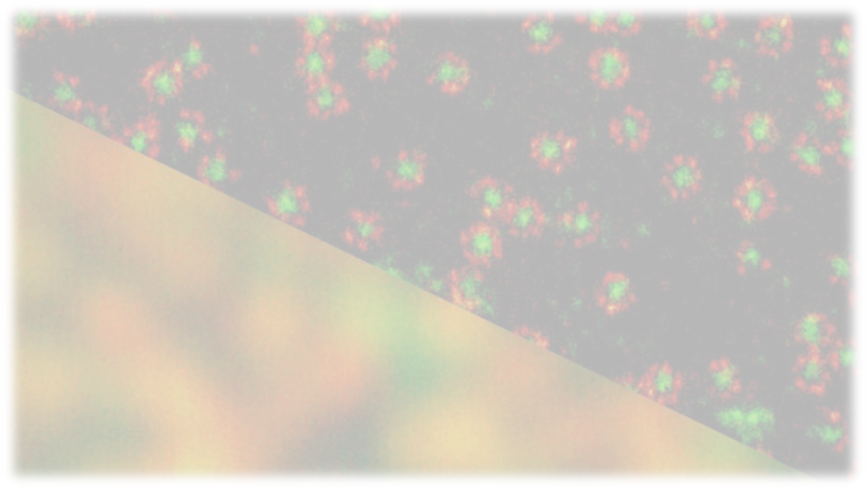
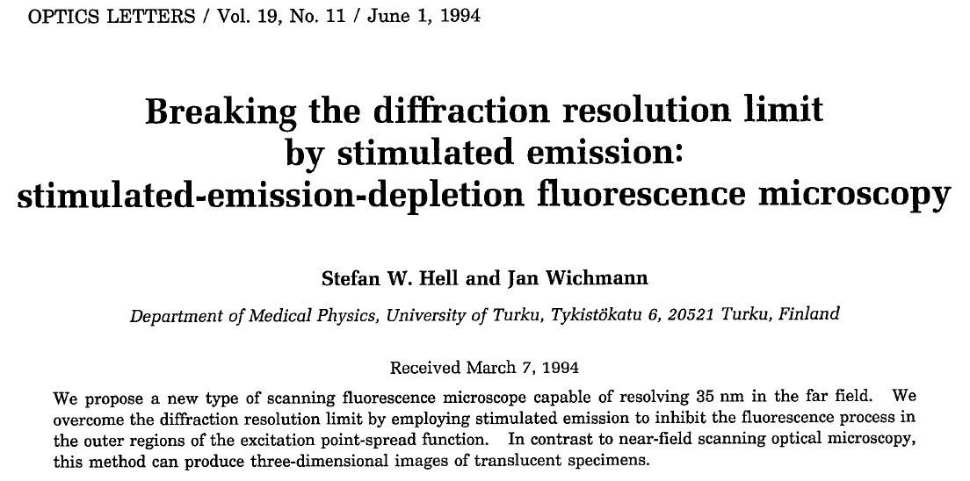
Stimulated Emission Depletion (STED) Microscopy
10

Slide 11
Basic Fluorescence

Slide 12
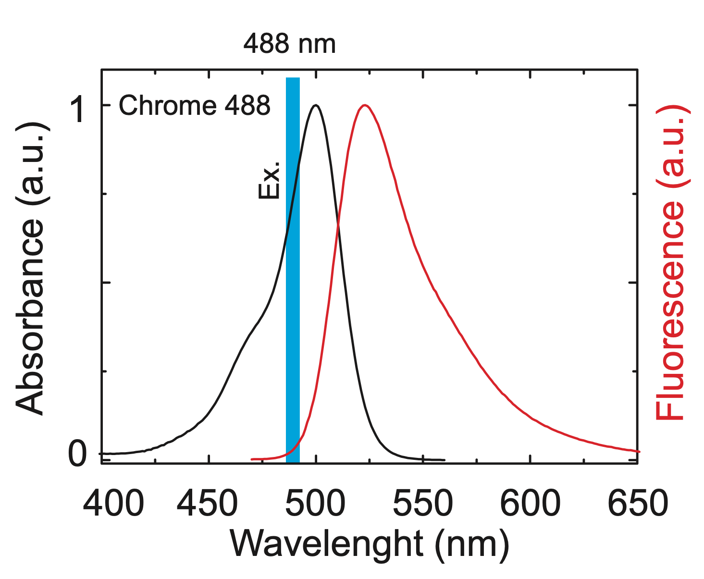
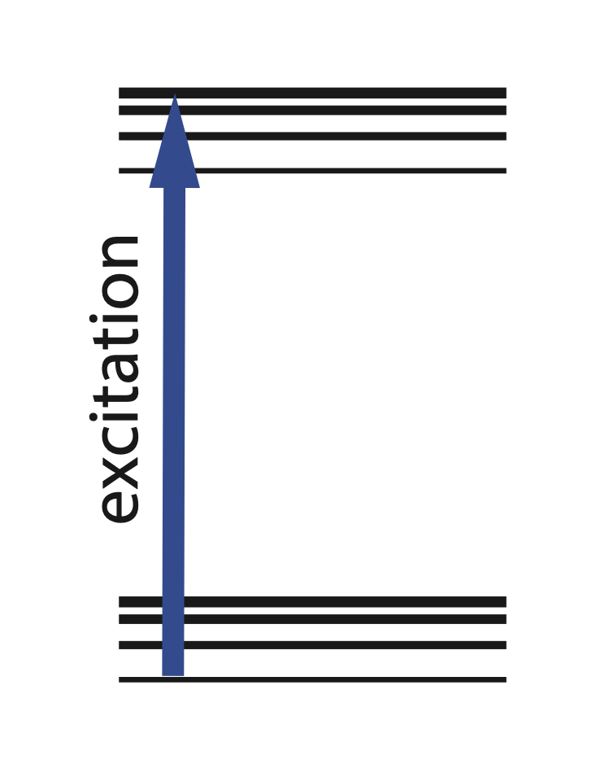
Fluorescence
Simplified Jablonski
Diagram
S1
}
vibrational
states
S0
}
vibrational
states
Excitation: absorption of a photon whose energies match with the molecule (10⁻¹⁵ s)
12

Slide 13
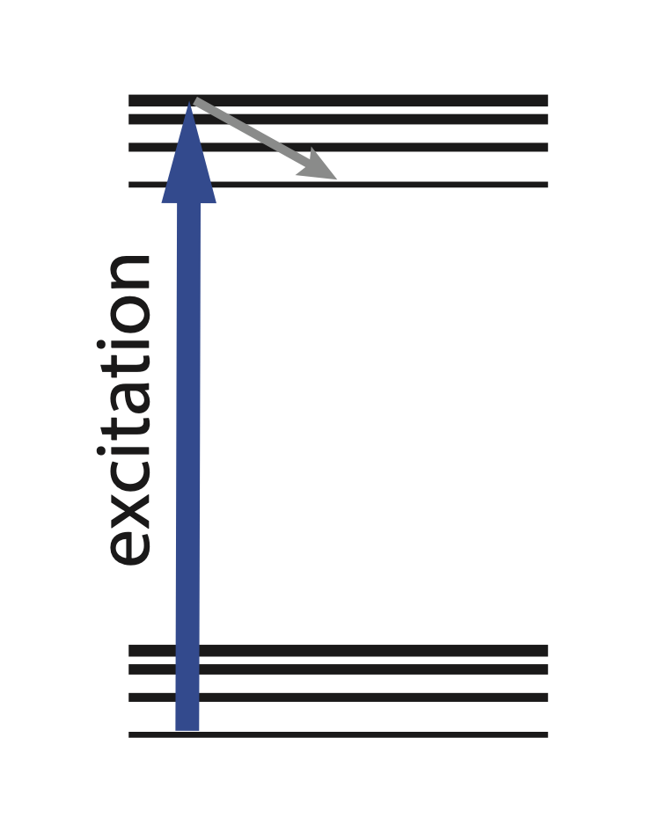
Fluorescence
Simplified Jablonski
Diagram
S1
}
vibrational
states
S0
}
vibrational
states
Excitation: absorption of a photon whose energies match with the molecule (10⁻¹⁵ s)
Vibrational Relaxation: relaxation to the lower vibrational level of the excited state (10⁻¹² s)
13

Slide 14
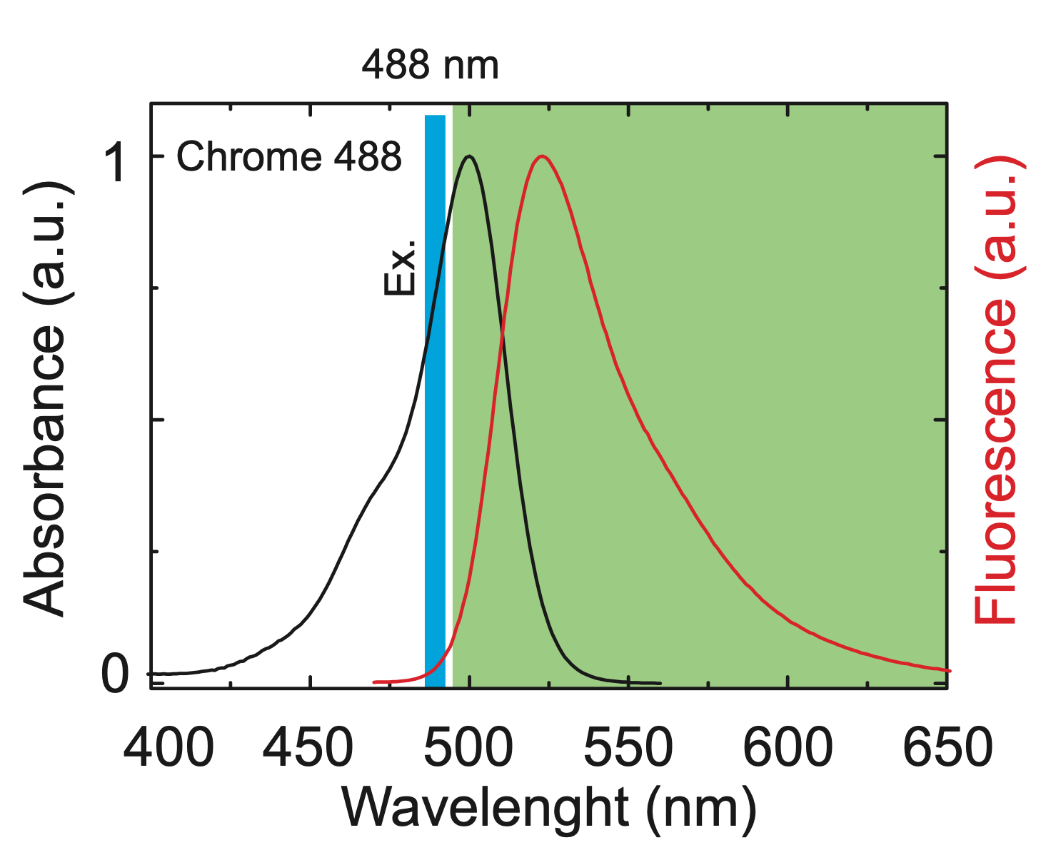
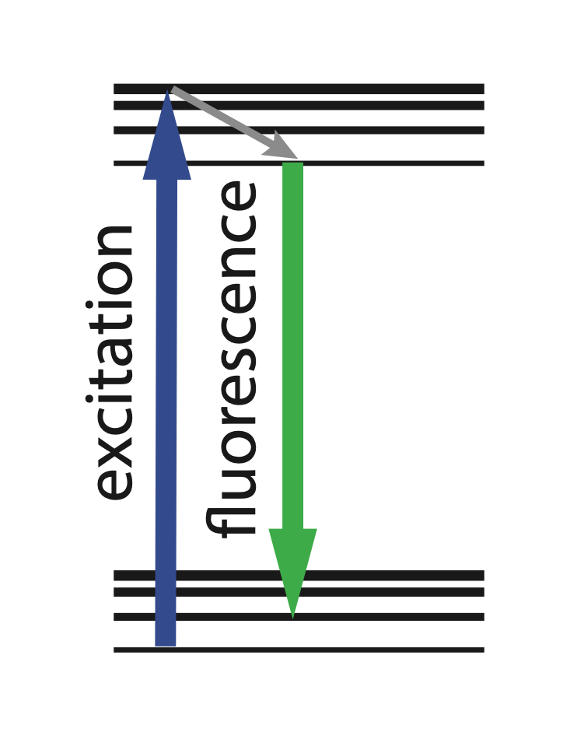
Fluorescence
Simplified Jablonski
Diagram
S1
}
vibrational
states
S0
}
vibrational
states
Excitation: absorption of a photon whose energies match with the molecule (10⁻¹⁵ s)
Vibrational Relaxation: relaxation to the lower vibrational level of the excited state (10⁻¹² s)
Fluorescent (Spontaneous) Emission: emission (10⁻¹⁵ s) of a photons at higher wavelength. Excited state lifetime (10⁻⁹ s)
14

Slide 15
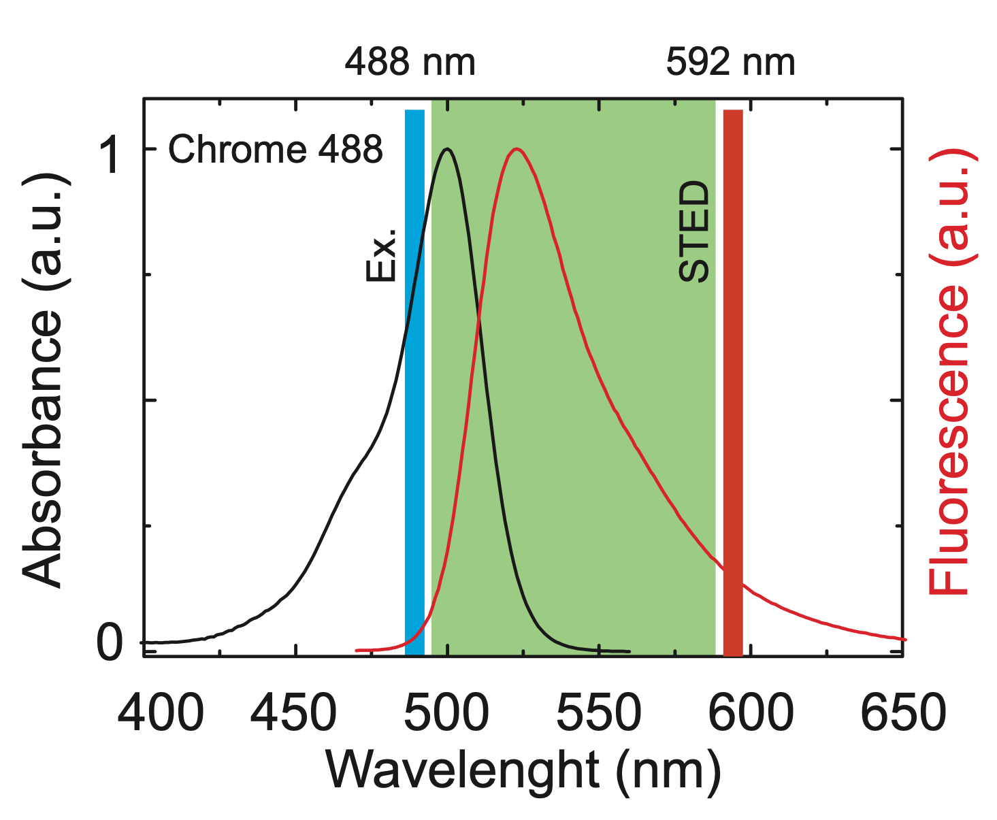
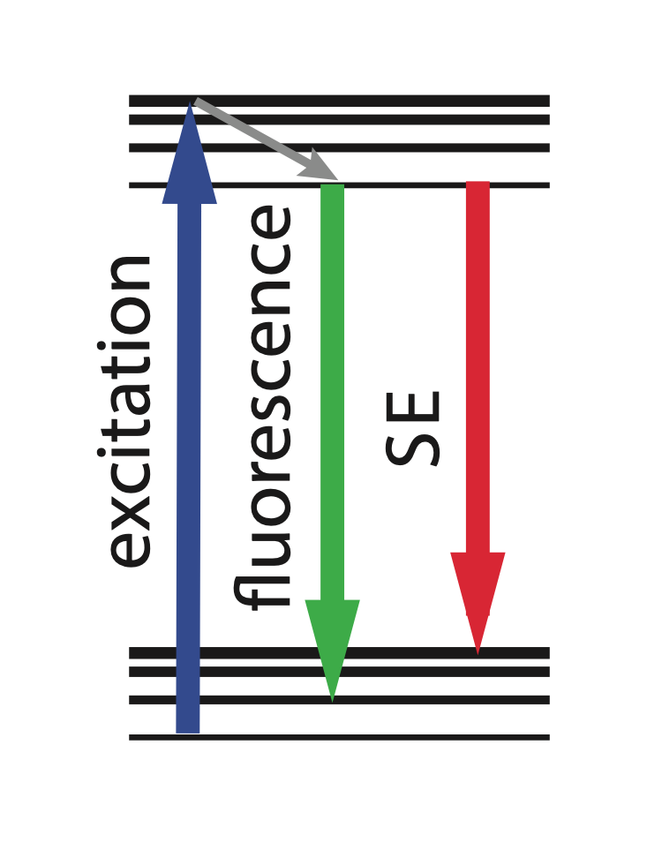
Fluorescence
Simplified Jablonski
Diagram
S1
}
vibrational
states
S0
}
vibrational
states
Excitation: absorption of a photon whose energies match with the molecule (10⁻¹⁵ s)
Vibrational Relaxation: relaxation to the lower vibrational level of the excited state (10⁻¹² s)
Fluorescent (Spontaneous) Emission: emission (10⁻¹⁵ s) of a photons at higher wavelength. Excited state lifetime (10⁻⁹ s)
Stimulated Emission: emission of an identical photon by providing a second stimulating photon
15

Slide 16
STED Microscopy
Notes:
With this bases of fluorescence

Slide 17
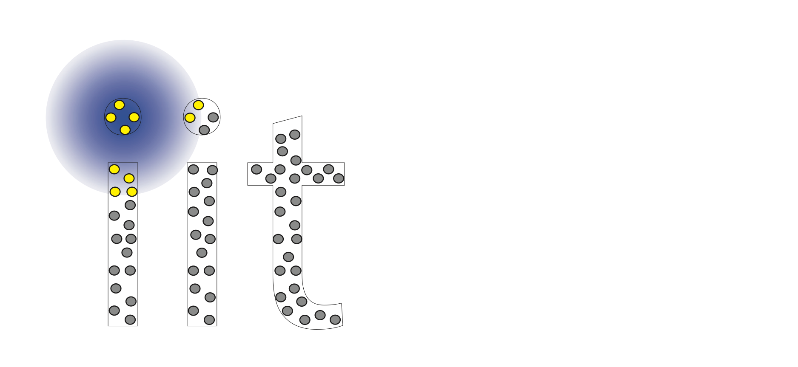
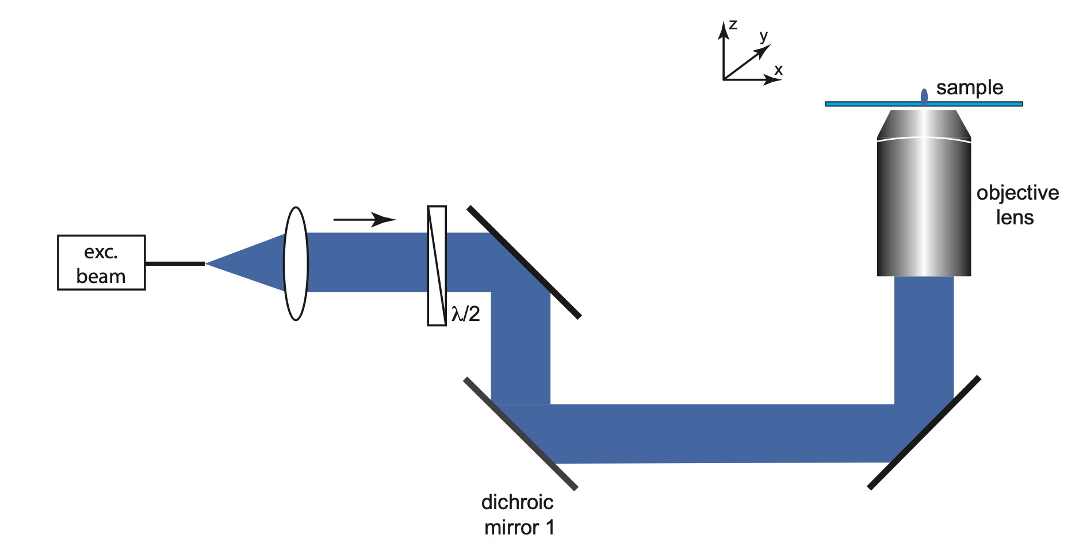

Diffraction (in a Laser Scanning Microscope)
Abbe E., Mikroscopische Anatomie 9:413-468 (1873)
d= 𝛌/(2*NA)
17
Notes:
How a STED microscope work? To understand how a STED microscope is able to reach sub diffraction spatial resolution it is necessary to understand why diffraction limits the resolution of a conventional fluorescence scanning microscope.

Slide 18
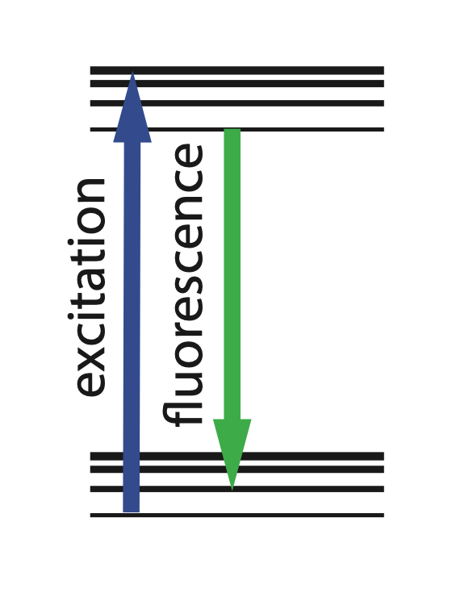
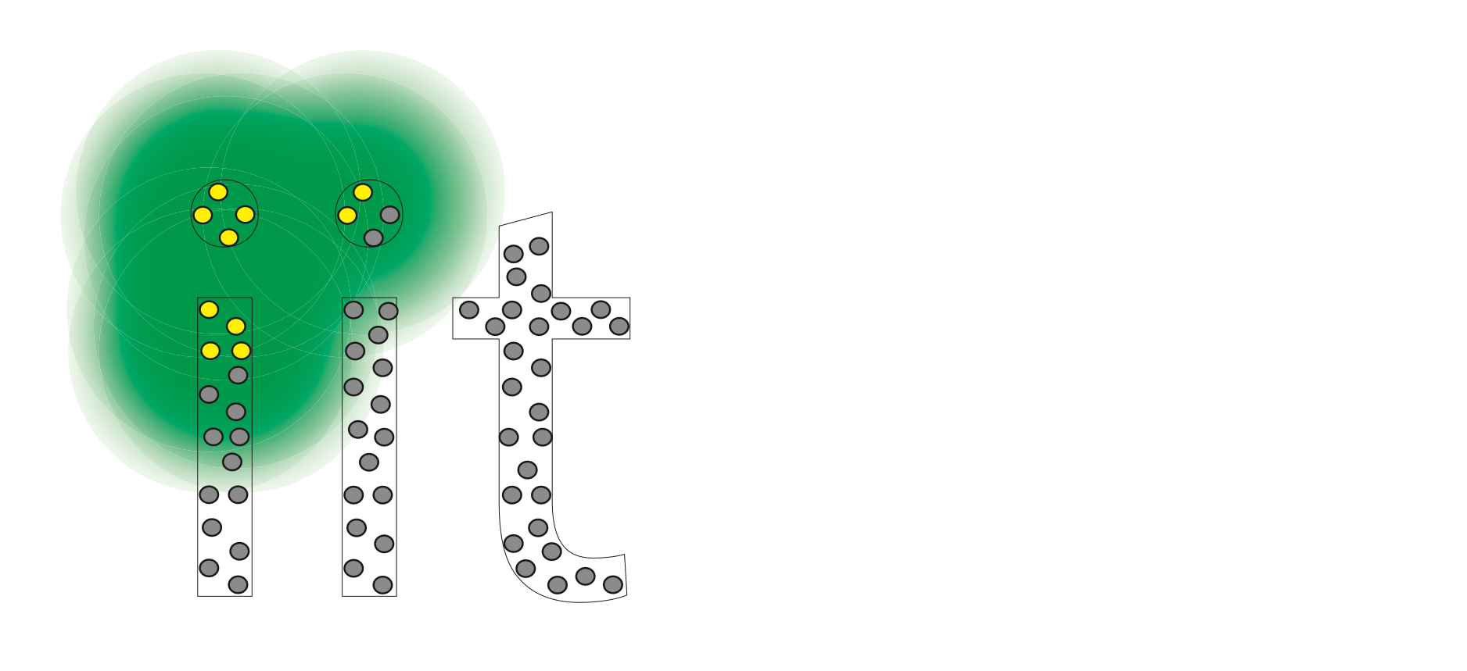
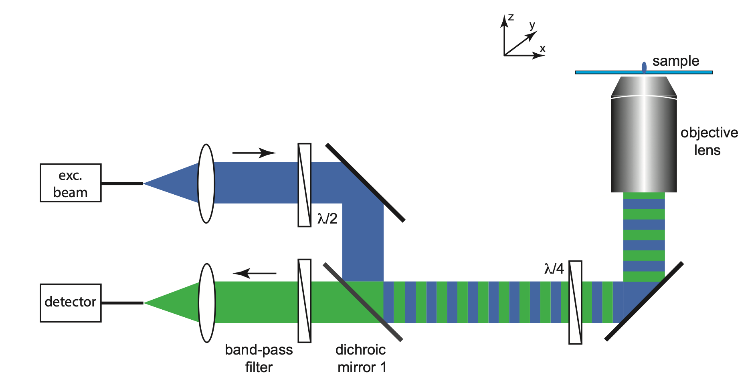
Diffraction (in a Laser Scanning Microscope)
Abbe E., Mikroscopische Anatomie 9:413-468 (1873)
d= 𝛌/(2*NA)
18

Slide 19

Diffraction (in a Laser Scanning Microscope)
Abbe E., Mikroscopische Anatomie 9:413-468 (1873)
d= 𝛌/(2*NA)
19

Slide 20
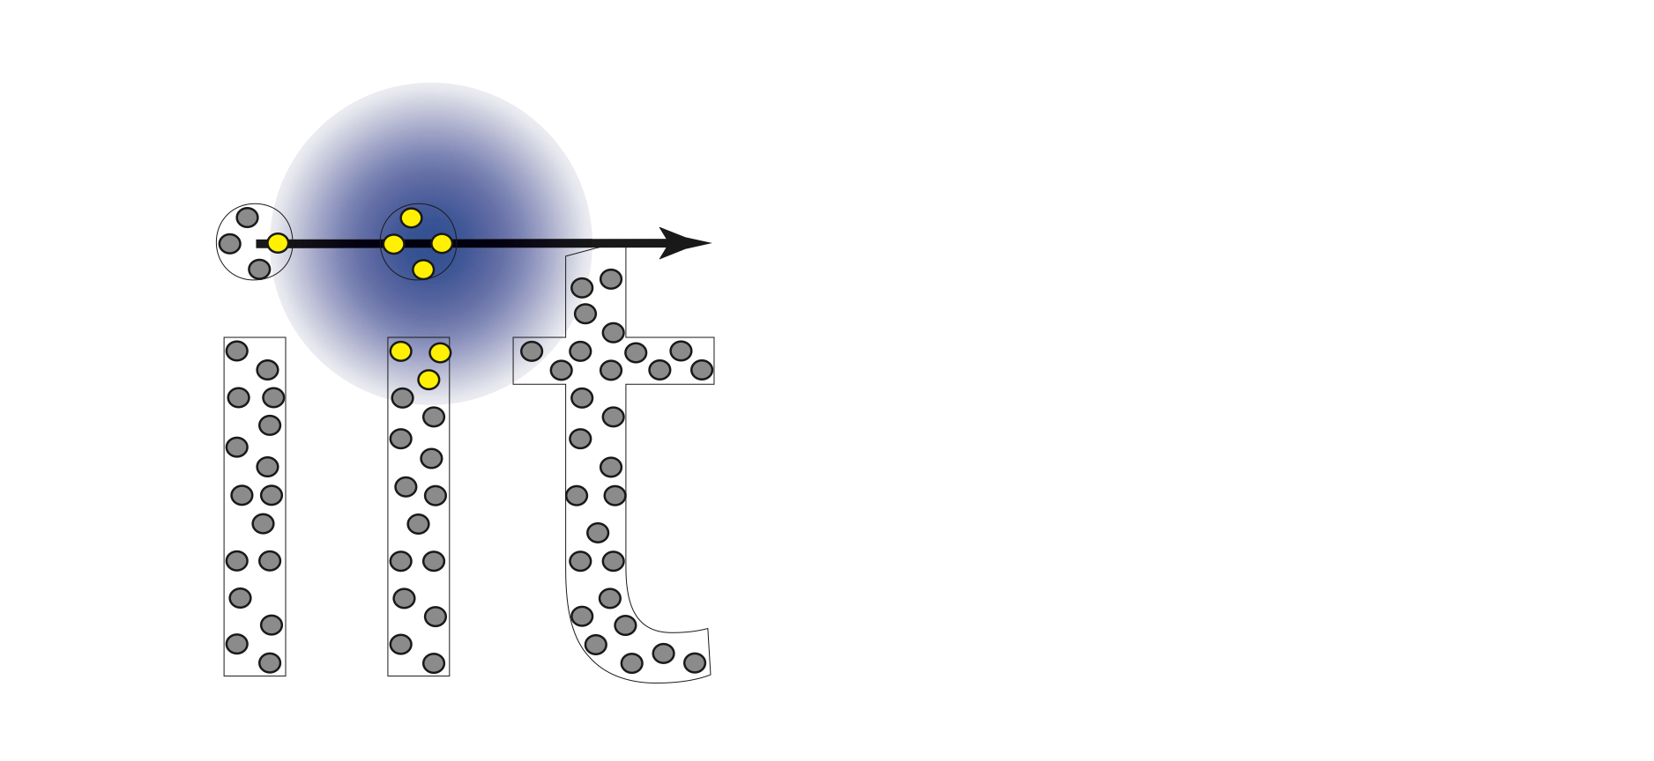
Diffraction (in a Laser Scanning Microscope)
Abbe E., Mikroscopische Anatomie 9:413-468 (1873)
d= 𝛌/(2*NA)
20

Slide 21
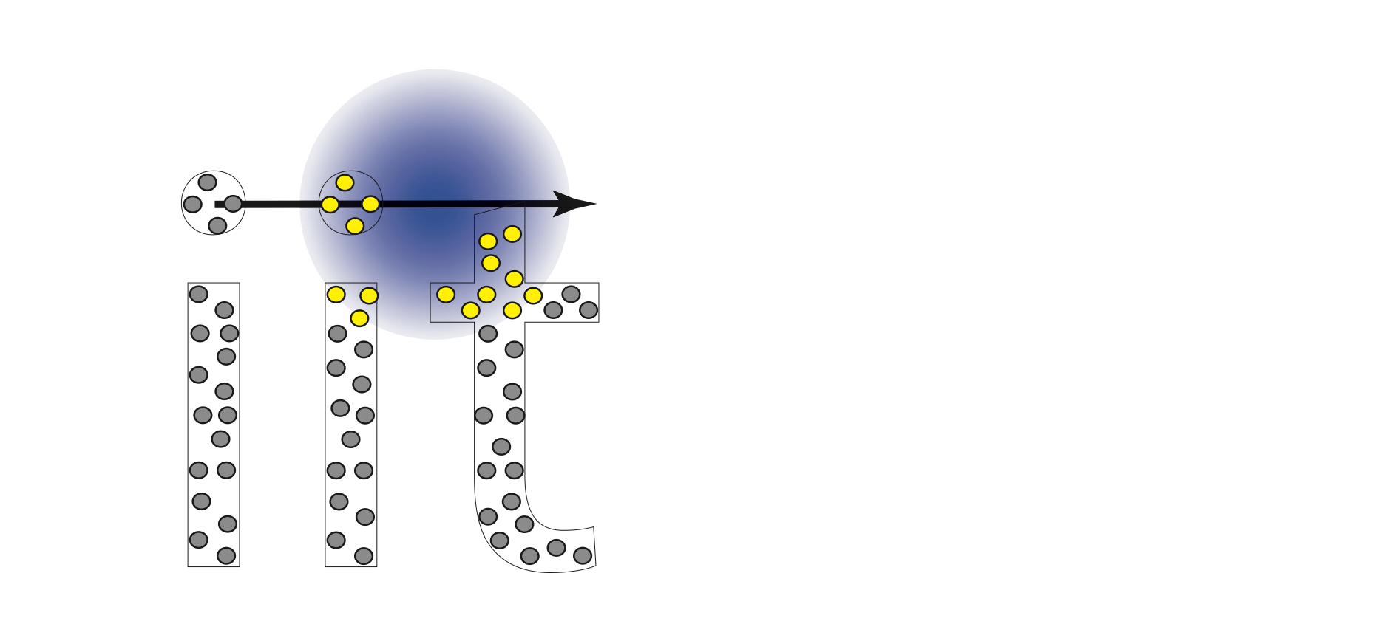
Diffraction (in a Laser Scanning Microscope)
Abbe E., Mikroscopische Anatomie 9:413-468 (1873)
d= 𝛌/(2*NA)
21

Slide 22
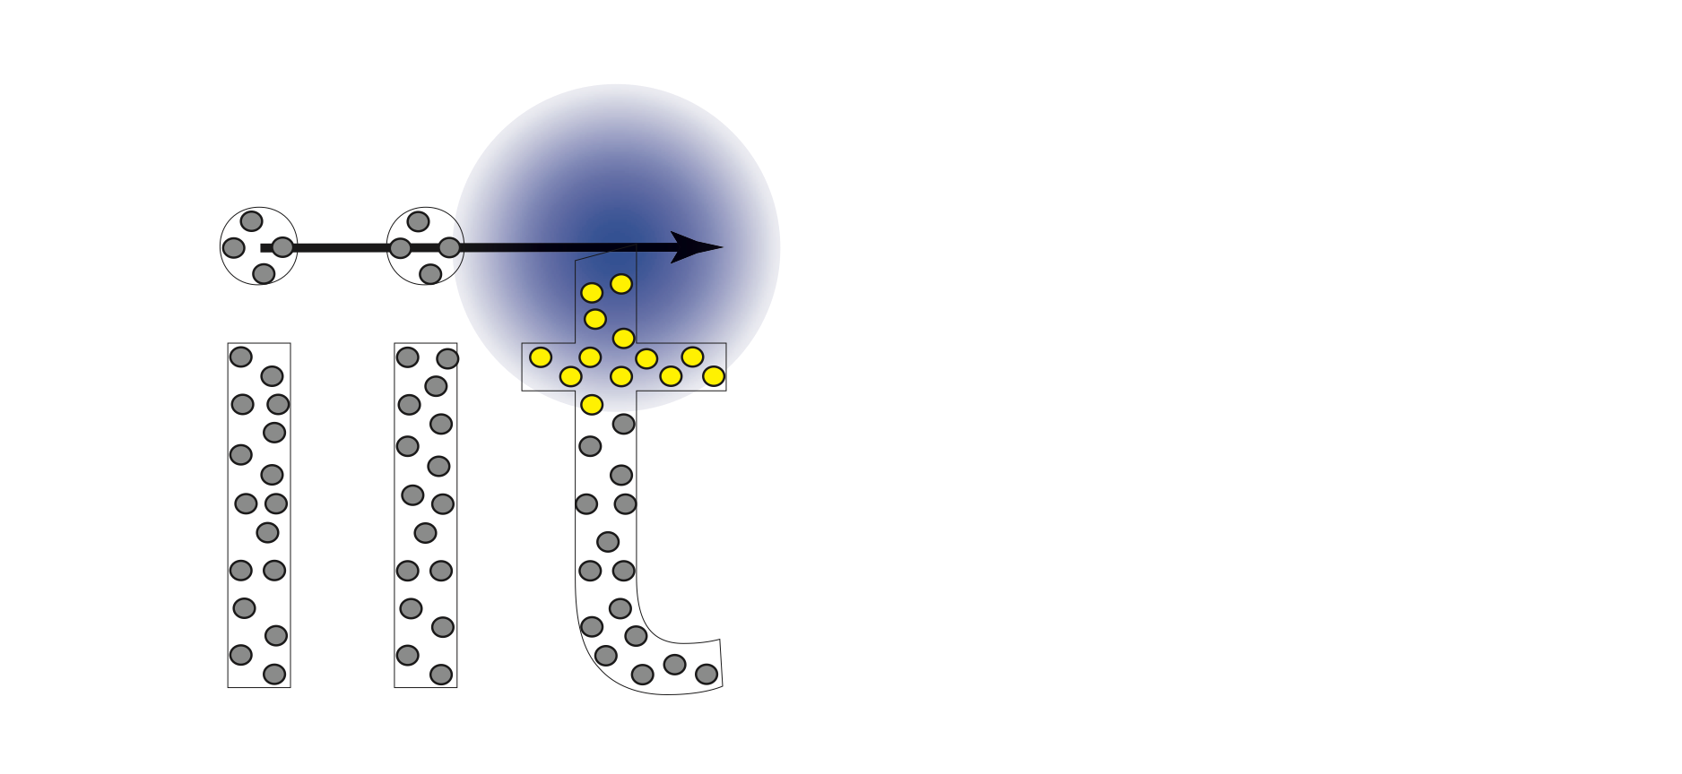
Diffraction (in a Laser Scanning Microscope)
Abbe E., Mikroscopische Anatomie 9:413-468 (1873)
d= 𝛌/(2*NA)
22

Slide 23
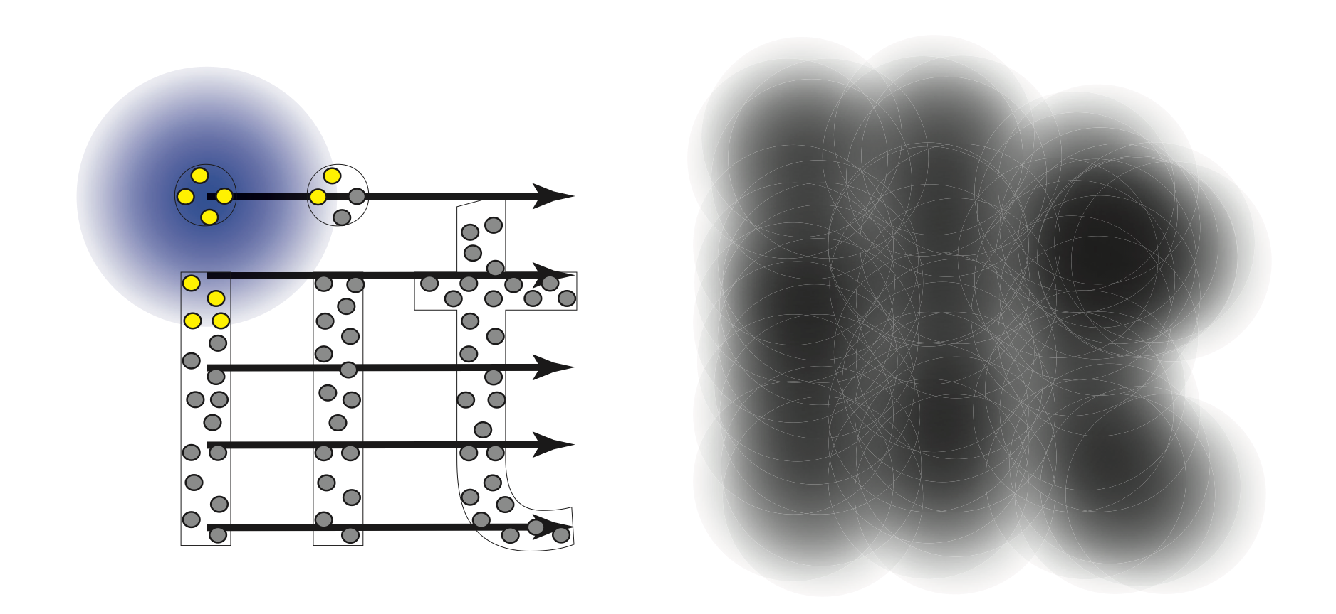
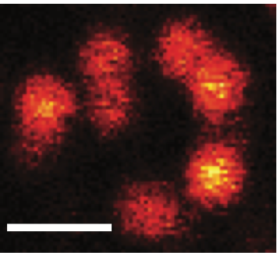
Diffraction (in a Laser Scanning Microscope)
Abbe E., Mikroscopische Anatomie 9:413-468 (1873)
d= 𝛌/(2*NA)
Vicidomini G.,…, Diaspro A., Methods, 66 (2), 124-130 (2014)
23
Notes:
Clearly, if there is a method to prevent the “simultaneous” emission from adjacent (closer to the diffraction limit) fluorophores, the spatial resolution of the system will be enhanced.

Slide 24
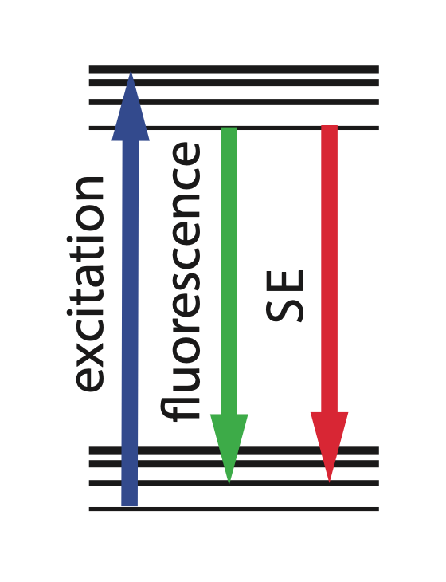
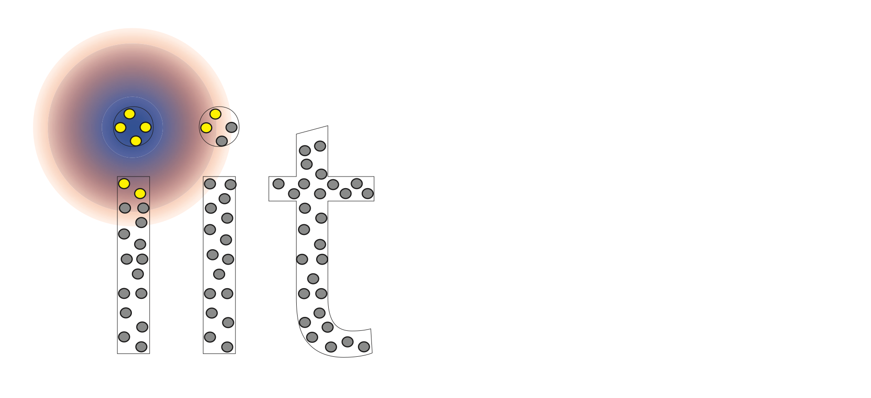

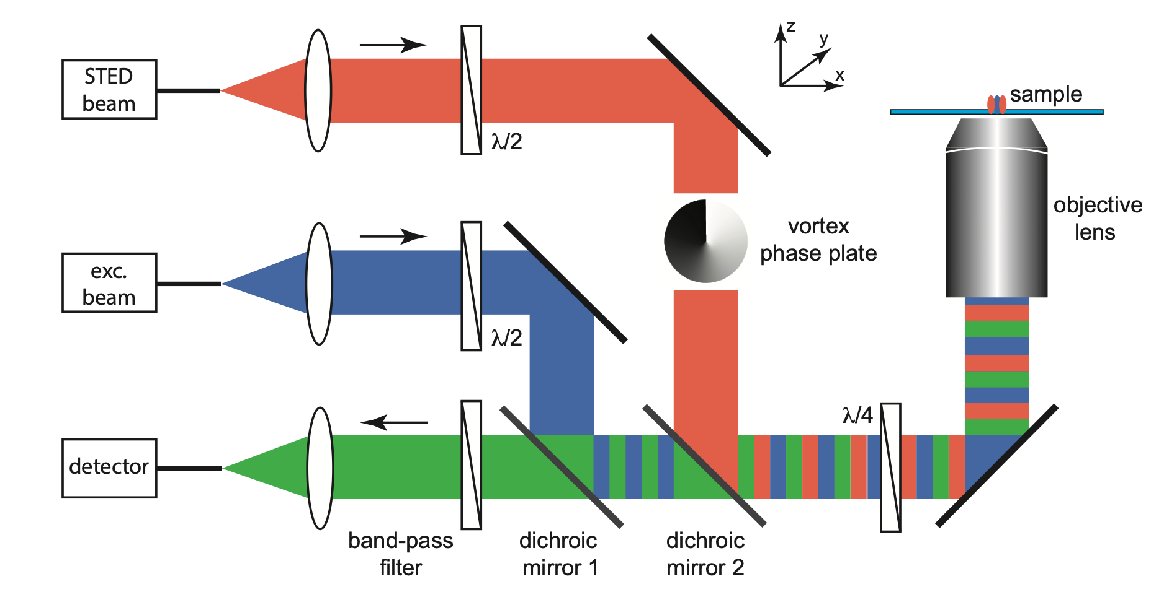
STED Microscopy
Hell S.W. and Wichmann J., Opt. Lett. 19, 780–782 (1994)
Vicidomini G.,…, Diaspro A., Nat,. Methods, 15:173–182 (2018)
Vicidomini G.,…, Diaspro A., Methods, 66 (2), 124-130 (2014)
24

Slide 25
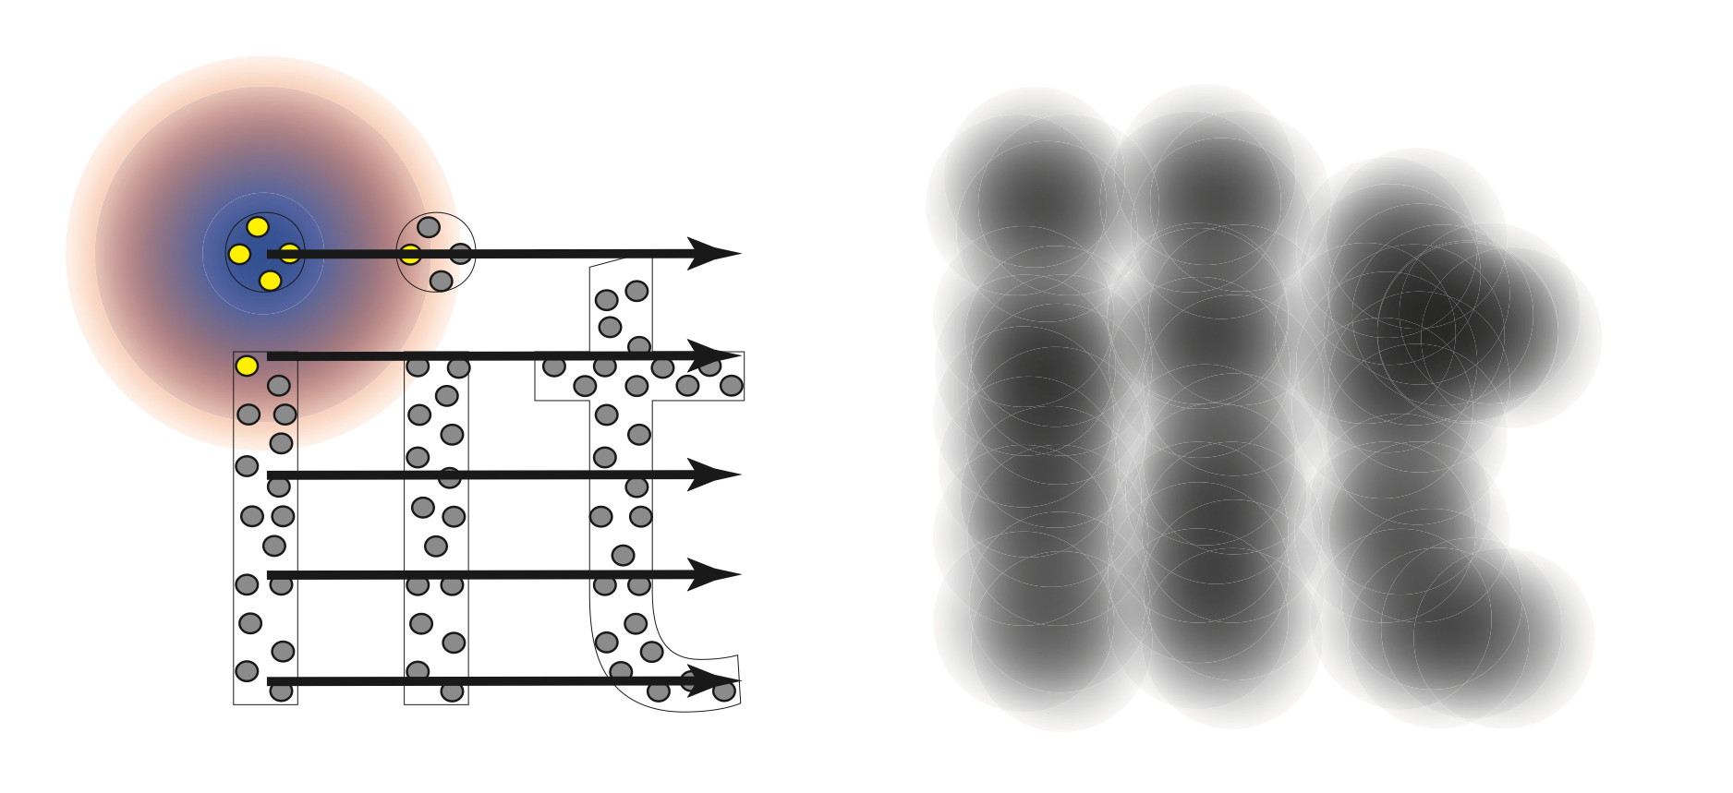
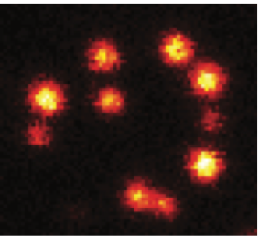
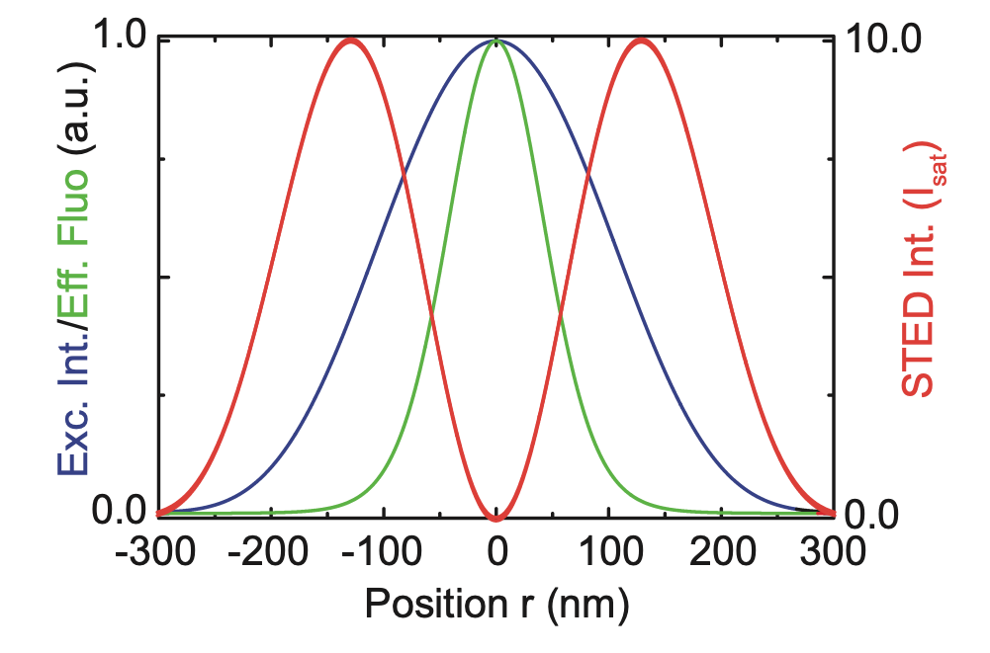
STED Microscopy
Hell S.W. and Wichmann J., Opt. Lett. 19, 780–782 (1994)
Vicidomini G.,…, Diaspro A., Nat,. Methods, 15:173–182 (2018)
Vicidomini G.,…, Diaspro A., Methods, 66 (2), 124-130 (2014)
25

Slide 26
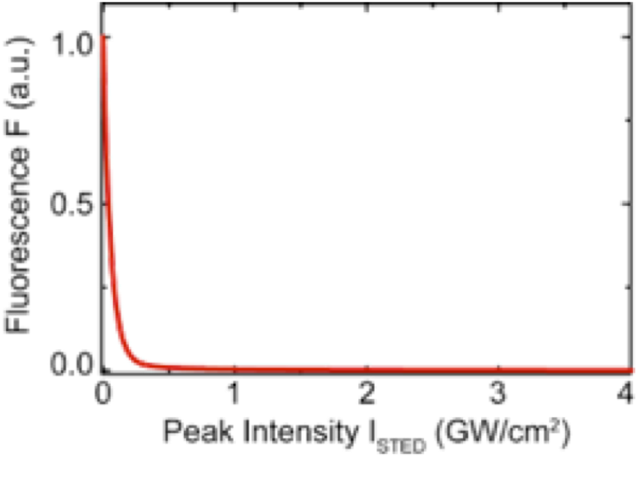
STED Microscopy
Hell S.W. and Wichmann J., Opt. Lett. 19, 780–782 (1994)
Vicidomini G.,…, Diaspro A., Nat,. Methods, 15:173–182 (2018)
Vicidomini G.,…, Diaspro A., Methods, 66 (2), 124-130 (2014)
ON
OFF
26

Slide 27
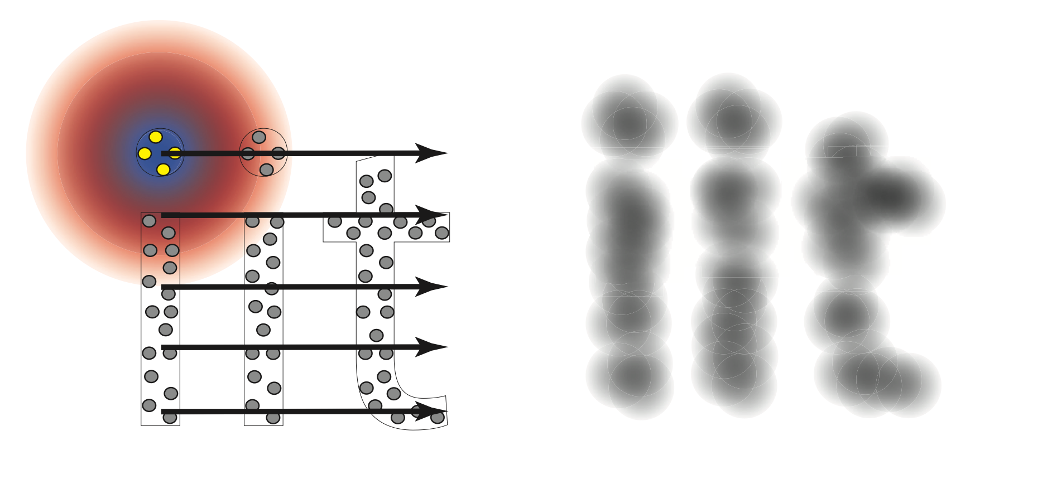

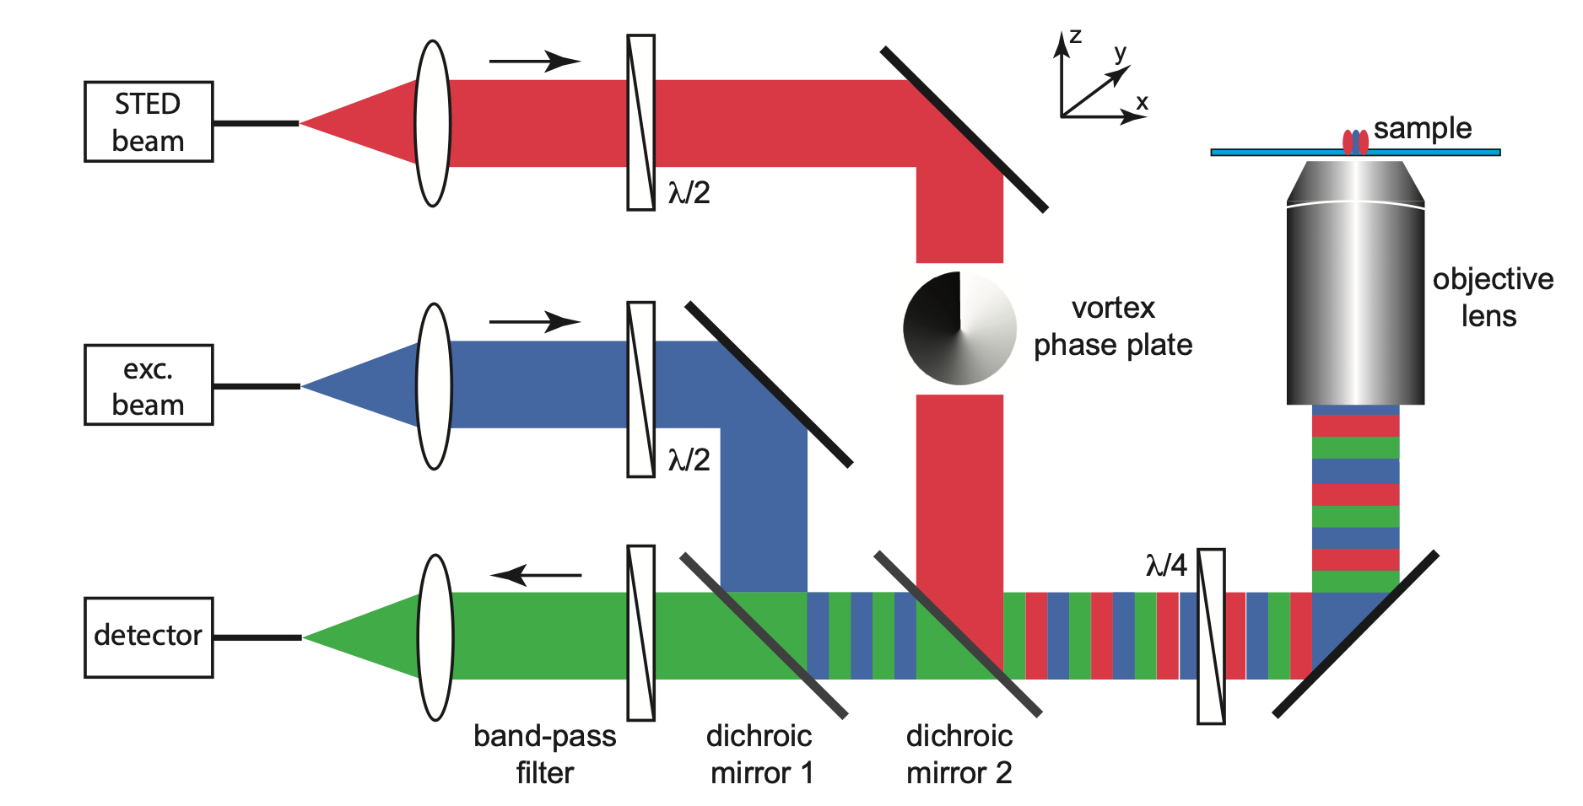
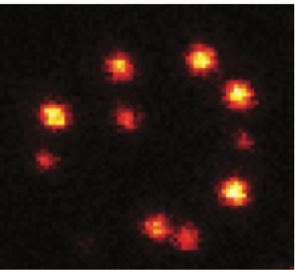
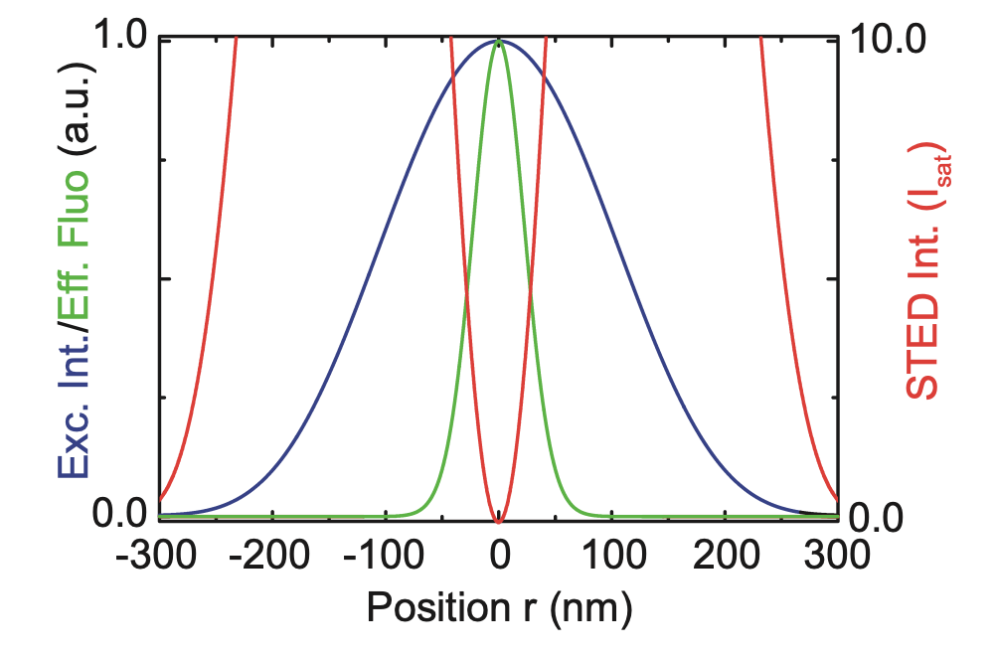
STED Microscopy
Hell S.W. and Wichmann J., Opt. Lett. 19, 780–782 (1994)
Vicidomini G.,…, Diaspro A., Nat,. Methods, 15:173–182 (2018)
d= 𝛌/(2*NA*√(1+I^{m}STED))
ON
OFF
Vicidomini G.,…, Diaspro A., Methods, 66 (2), 124-130 (2014)
ON
OFF
27

Slide 28
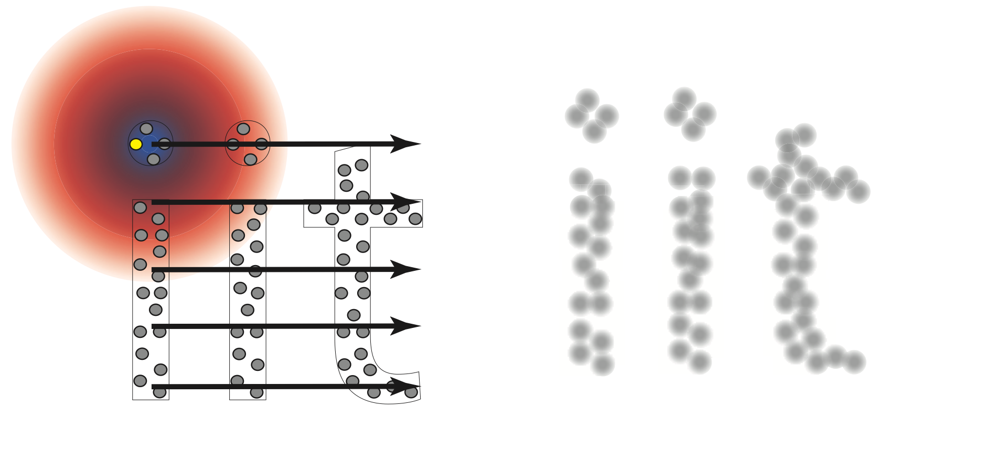

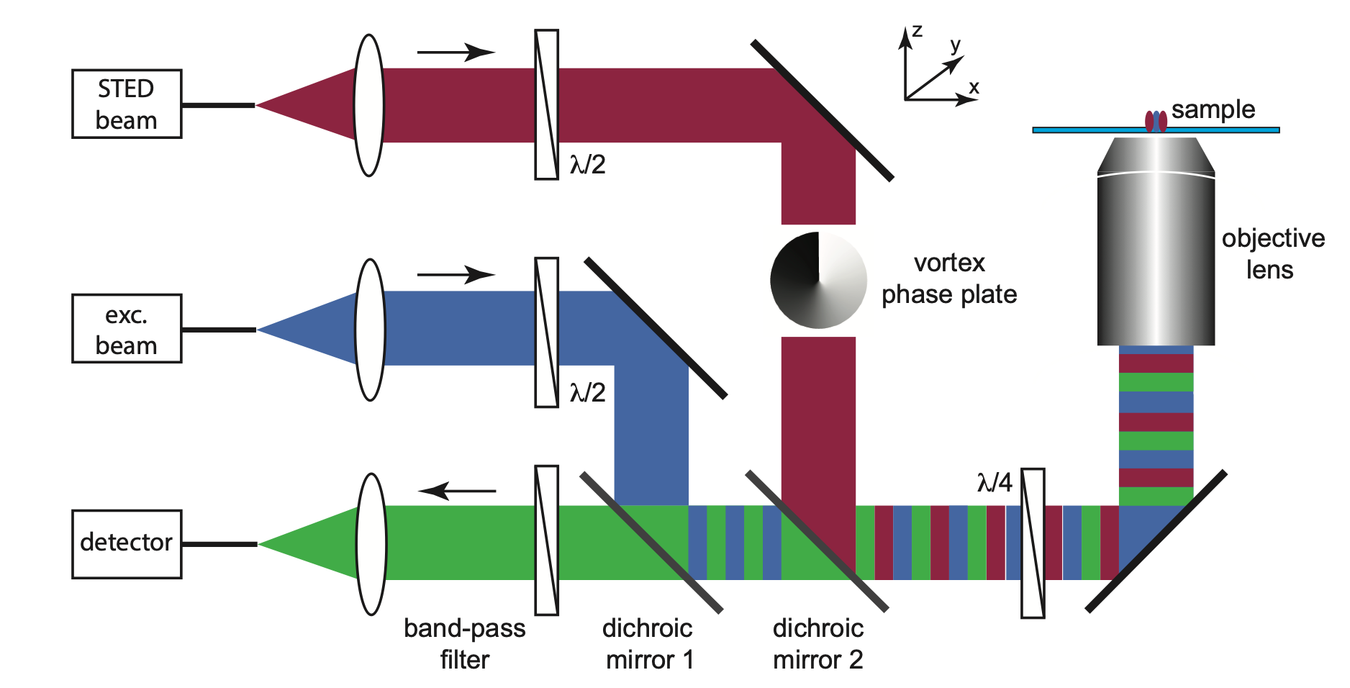
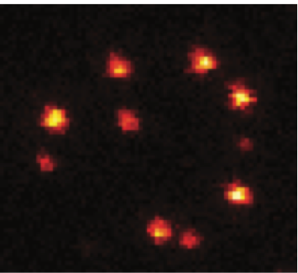
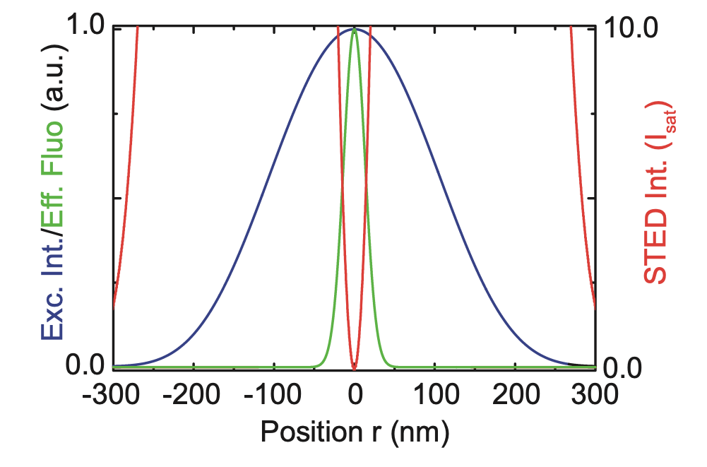
STED Microscopy
Hell S.W. and Wichmann J., Opt. Lett. 19, 780–782 (1994)
Vicidomini G.,…, Diaspro A., Nat,. Methods, 15:173–182 (2018)
d= 𝛌/(2*NA*√(1+I^{m}STED))
ON
OFF
Vicidomini G.,…, Diaspro A., Methods, 66 (2), 124-130 (2014)
ON
OFF
28

Slide 29
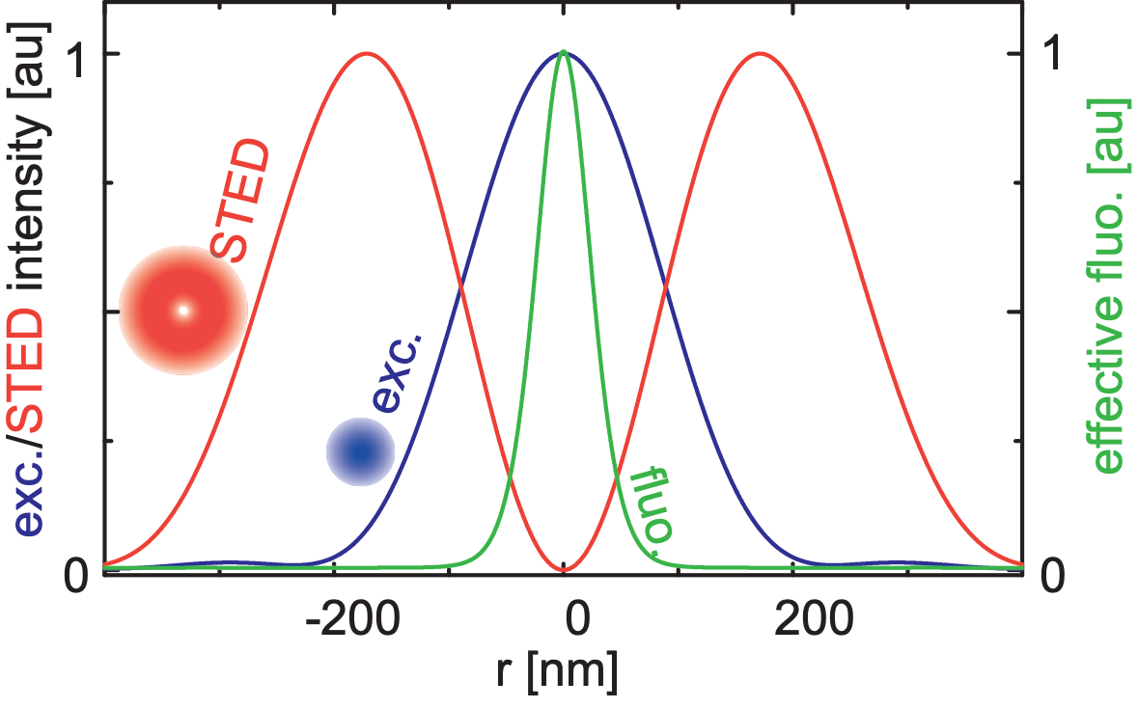
STED Conditions
Vicidomini G.,…, Diaspro A., Nat,. Methods, 15:173–182 (2018)
Spatial condition: the STED beam and the excitation beam foci have to coincide with nanometres precision and the residual STED beam’s intensity in the “zero”-intensity point has to be minimised
Galiani, S.,…, Bianchini, P., Opt. Express, 20(7):7362-7374 (2012)
29

Slide 30
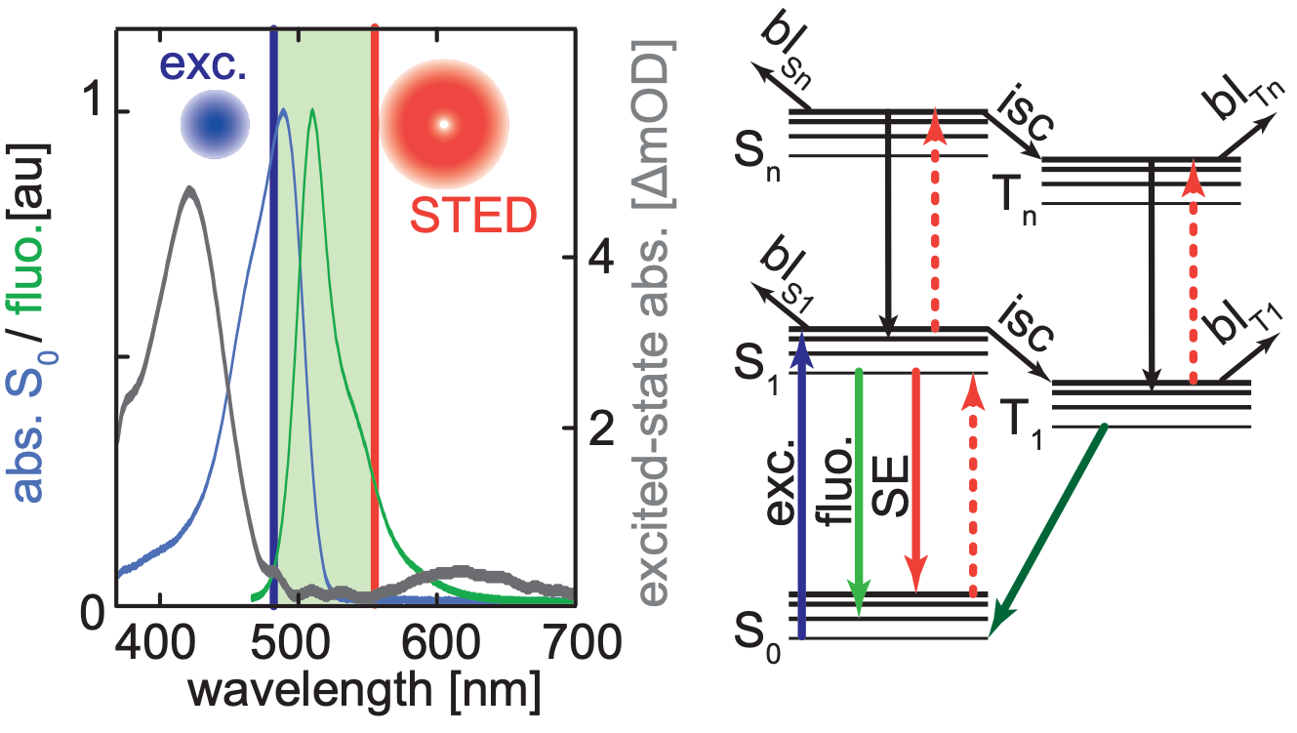
STED Conditions
Vicidomini G.,…, Diaspro A., Nat,. Methods, 15:173–182 (2018)
Spatial condition: the STED beam and the excitation beam foci have to coincide with nanometres precision and the residual STED beam’s intensity in the “zero”-intensity point has to be minimised
Galiani, S.,…, Bianchini, P., Opt. Express, 20(7):7362-7374 (2012)
Spectral condition: the STED beam wavelength has to be chosen to maximise stimulated emission and minimise fluorophore absorption
Rankin B.R.,…, Hell S.W., Biophys. J., 100, L63-L65 (2011)
30

Slide 31
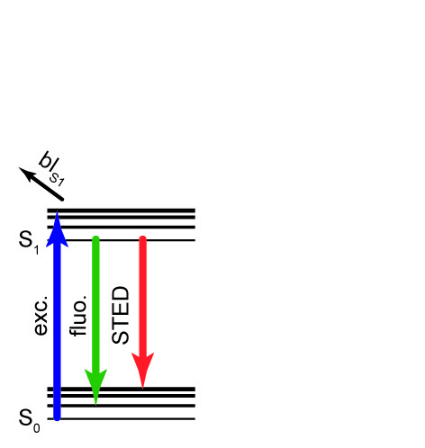
Spectral Conditions
The wavelength of the STED beam is set to maximise the quenching of the excited fluorophores via stimulated emission and to minimise any other processes that can compete
with stimulated emission
Castello M.,…, Vicidomini G., Review of Sci. Instr,, In Press
31

Slide 32
Spectral Conditions
The wavelength of the STED beam is set to maximise the quenching of the excited fluorophores via stimulated emission and to minimise any other processes that can compete
with stimulated emission
Castello M.,…, Vicidomini G., Review of Sci. Instr,, In Press
32

Slide 33
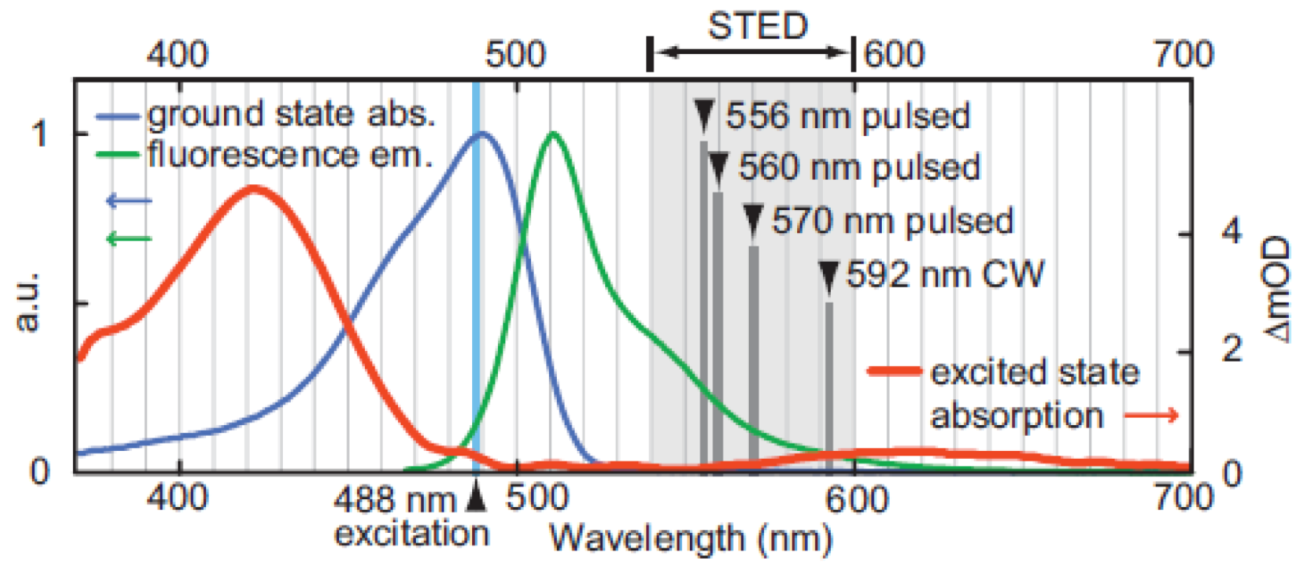
Spectral Conditions
The wavelength of the STED beam is set to maximise the quenching of the excited fluorophores via stimulated emission and to minimise any other processes that can compete
with stimulated emission
green
fluoresce
protein
(GFP)
Rankin B.R,…, Hell S.W., Biophys. J., 100, L63-L65 (2011)
Photobleaching reduces by choosing wavelength of the STED beam outside the excited-state absorption spectra,
Castello M.,…, Vicidomini G., Review of Sci. Instr,, In Press
33

Slide 34
Spectral Conditions
The wavelength of the STED beam is set to maximise the quenching of the excited fluorophores via stimulated emission and to minimise any other processes that can compete
with stimulated emission
green
fluoresce
protein
(GFP)
Rankin B.R,…, Hell S.W., Biophys. J., 100, L63-L65 (2011)
Photobleaching reduces by choosing wavelength of the STED beam outside the excited-state absorption spectra,
but - red-shifting the STED beam reduces the stimulated emission cross section; - blu-shifting the STED beam increases the probability to excite directly the fluorophore.
Castello M.,…, Vicidomini G., Review of Sci. Instr,, In Press
34

Slide 35
Sync-STED Microscopy

Slide 36
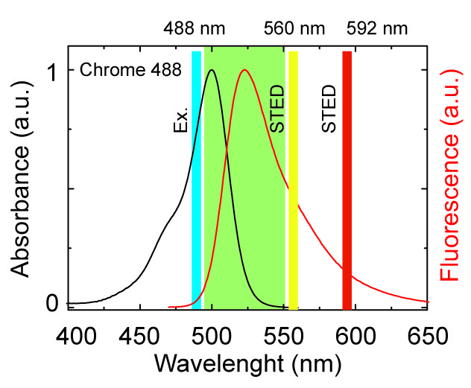
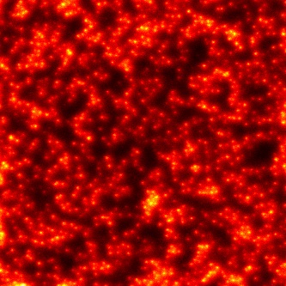
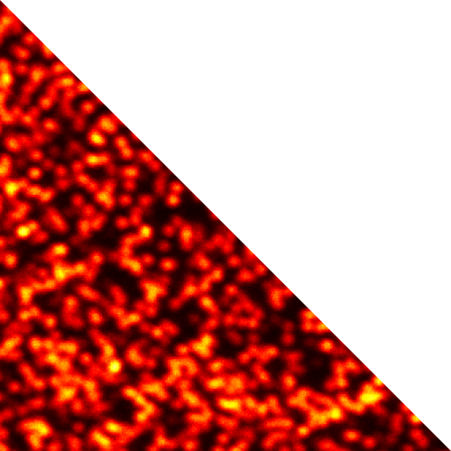
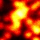
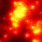
Synchronous STED
If the absorption of the STED beam is not negligible a background (anti-Stokes emission background) substantially reduces the effective spatial resolution.
Confocal
Confocal
CW-STED
CW-STED
CW-STED
36

Slide 37
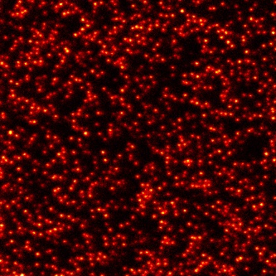



Synchronous STED
If the absorption of the STED beam is not negligible a background (anti-Stokes emission background) substantially reduces the effective spatial resolution.
The anti-Stokes emission background cannot be spectrally filtered but since it is induced solely by the STED beam it can be removed by a lock-in (synchronous detection) approach
CW-STED (sync)
Digital lock-in (syncrounous detection) directly integrated in the microscope data-acquisition card (FPGA-based)
Confocal
pixel dwell-time
excitation
time
STED
CW-STED
open
close
-
=
(sync)
Castello M.,…, Vicidomini G., Review of Sci. Instr,, 88, 053701 (2017)
37

Slide 38

Anti-Stokes Emission Background Removal
The excitation beam is modulated and the uncorrelated anti-Stokes emission background is “subtracted” (the background from early emission is also removed integrating the approaches in a time-resolved STED architecture):
Vicidomini G. et al. Opt. Express, 20:5225–5236 (2012)
Ronzitti E. et al. Opt. Express 21:210–219 (2013)
Hernandez I.C. et al. J. Biophoton. 7:376–80 (2014)
Hanne J. et al. Nat. Commun. 6:7127 (2015)
Lanzanò L. et al. Nat. Commun. 6:6701 (2015)
Castello M. et al. Review of Sci. Instr. 88:053701 (2017)
The anti-Stokes emission background is “subtracted" via image deconvolution to improve the SNR:
Hernandez I.C. et al. Sci. Rep. 6:19419 (2016) Castello M. et al. Review of Sci. Instr. 88:053701 (2017)
Hernandez. I.C. et al. Neurophotonics 6:045004 (2019)
The background from incomplete depletion is also removed:
Gao P. et al. Nature Photon 11:163–169 (2017)
Lee J.C. et al. ACS Photonics 6:1789-1797 (2019)
A recent review on this topic Ma Y., et al. Phys. Biol. 16:051002 (2019)
Castello M.,…, Vicidomini G., Review of Sci. Instr., 88, 053701 (2017)
38

Slide 39

STED Conditions (Temporal)
Vicidomini G.,…, Diaspro A., Nat,. Methods, 15:173–182 (2018)
Spatial condition: the STED beam and the excitation beam foci have to coincide with nanometres precision and the residual STED beam’s intensity in the “zero”-intensity point has to be minimised
Galiani, S.,…, Bianchini, P., Opt. Express, 20(7):7362-7374 (2012)
Spectral condition: the STED beam wavelength has to be chosen to maximise stimulated emission and minimise fluorophore absorption
Rankin B.R.,…, Hell S.W., Biophys. J., 100, L63-L65 (2011)
Temporal condition: the STED beam photons (stimulating photons) have to act when fluorophores are in the singlet-excited state S1
Vicidomini, G.,…, Hell, S.W., PLoS ONE, 8(1):e54421 (2013)
39

Slide 40
Temporal Conditions
The depletion of the fluorescent signal depends on the number of stimulating photons to which the fluorophore is exposed while residing in the singlet-excited state S1
~ ps
S1
~ ns
stimulated emission photon cross-section 𝜎SE = 25 cm²/J
excited-state S1 lifetime 𝜏S1 = 4 ns
Isat = 10 MW/cm²
I^{m}STED ~ GW/cm²
complex pulsed lasers architecture
photo-damage effects
S0
40
Notes:
The reason why the stimulating photons have to act when fluorophores are in the singlet-excited state S1, is because the suppression of fluorescence depends on the number of stimulating photons to which the fluorophore is exposed while residing in the excite-state.
However, since typically organic fluorophores have lifetime in the order of nanoseconds and the crosse section of stimulate at the STED beam wavelength is relatively low, Intensity of the STED beam of the order of GW/cm2 are requested to effectively reach tens of nanometer resolutions
For this reason the most natural way to efficiently quench a fluorophore is to synchronise the excitation events with the stimulating photons which can be achieved with a train of synchronised excitation and stimulating pulses, in which the stimulating pulse follows instantaneously the excitation pulse.
For organic fluorophore with a lifetime of few nanoseconds, hundreds picosecond stimulating pulse (i) ensures that all the stimulating photons acts while the fluorophore is in the excited state, allows (ii) to the fluorophore to relax from the vibrational states.
However, since stimulated emission cross-section is in the order of 𝜎SE = 10-16cm2, also with few hundreds picosecond pulses the peak intensity to effectively quench a fluorohore is in the order of GW/cm2.
Clearly, this value is well above the intensity values used to excite the fluorophores (below the intensity use in two-photon-excitation) thus prone to induce photo-bleaching and photo-toxicity in living sample.

Slide 41
Temporal Conditions
The depletion of the fluorescent signal depends on the number of stimulating photons to which the fluorophore is exposed while residing in the singlet-excited state S1
~ ps
S1
~ ns
stimulated emission photon cross-section 𝜎SE = 25 cm²/J
excited-state S1 lifetime 𝜏S1 = 4 ns
Isat = 10 MW/cm²
I^{m}STED ~ GW/cm²
complex pulsed lasers architecture
photo-damage effects
S0
- long lifetime fluorophores;
41
Notes:
The suppression of fluorescence depends on the number of stimulating photons to which the fluorophore is exposed while residing in the excite-state.
For this reason the most natural way to efficiently quench a fluorophore is to synchronise the excitation events with the stimulating photons which can be achieved with a train of synchronised excitation and stimulating pulses, in which the stimulating pulse follows instantaneously the excitation pulse.
For organic fluorophore with a lifetime of few nanoseconds, hundreds picosecond stimulating pulse (i) ensures that all the stimulating photons acts while the fluorophore is in the excited state, allows (ii) to the fluorophore to relax from the vibrational states.
However, since stimulated emission cross-section is in the order of 𝜎SE = 10-16cm2, also with few hundreds picosecond pulses the peak intensity to effectively quench a fluorohore is in the order of GW/cm2.
Clearly, this value is well above the intensity values used to excite the fluorophores (below the intensity use in two-photon-excitation) thus prone to induce photo-bleaching and photo-toxicity in living sample.

Slide 42
Temporal Conditions
The depletion of the fluorescent signal depends on the number of stimulating photons to which the fluorophore is exposed while residing in the singlet-excited state S1
~ ps
S1
~ ns
stimulated emission photon cross-section 𝜎SE = 25 cm²/J
excited-state S1 lifetime 𝜏S1 = 4 ns
Isat = 10 MW/cm²
I^{m}STED ~ GW/cm²
complex pulsed lasers architecture
photo-damage effects
S0
- long lifetime fluorophores;
time-gating detection: registering fluorescence signal only after a certain time Tg from the fluorophores’ excitation events ensures that the signal stems fromfluorophores that have resided into the excited-state at least a time Tg
42
Notes:
The suppression of fluorescence depends on the number of stimulating photons to which the fluorophore is exposed while residing in the excite-state.-
For this reason the most natural way to efficiently quench a fluorophore is to synchronise the excitation events with the stimulating photons which can be achieved with a train of synchronised excitation and stimulating pulses, in which the stimulating pulse follows instantaneously the excitation pulse.
For organic fluorophore with a lifetime of few nanoseconds, hundreds picosecond stimulating pulse (i) ensures that all the stimulating photons acts while the fluorophore is in the excited state, allows (ii) to the fluorophore to relax from the vibrational states.
However, since stimulated emission cross-section is in the order of 𝜎SE = 10-16cm2, also with few hundreds picosecond pulses the peak intensity to effectively quench a fluorohore is in the order of GW/cm2.
Clearly, this value is well above the intensity values used to excite the fluorophores (below the intensity use in two-photon-excitation) thus prone to induce photo-bleaching and photo-toxicity in living sample.

Slide 43
gated-STED Microscopy

Slide 44



Gated-STED Principle
Excitation
~ ps
STED
S1
~ ns
Detection
S0
𝜏fl = 1/(kfl+kSTED)
Vicidomini G.,…, Hell S.W., PLOS One, 8(1): e544210 (2013)
Moffitt J.R, Osseforth C and Michaelis J. Opt. Express. 19(5):4242-4254 (2011)
44
Notes:
To understand why time-gating reduces the STED beam intensity requested to obtain a certain sub-diffraction resolution it is necessary to investigate the fluorescent dynamic in a STED experiments.

Slide 45

Gated-STED Principle
Excitation
~ ps
STED
S1
~ ns
Detection
Tg
S0
𝜏fl = 1/(kfl+kSTED)
Vicidomini G.,…, Hell S.W., PLOS One, 8(1): e544210 (2013)
Moffitt J.R, Osseforth C and Michaelis J. Opt. Express. 19(5):4242-4254 (2011)
45

Slide 46

Gated-STED Principle
Excitation
~ ps
STED
S1
~ ns
Detection
Tg
S0
𝜏fl = 1/(kfl+kSTED)
Vicidomini G.,…, Hell S.W., PLOS One, 8(1): e544210 (2013)
Moffitt J.R, Osseforth C and Michaelis J. Opt. Express. 19(5):4242-4254 (2011)
46

Slide 47


Gated-STED Principle
Excitation
~ ps
STED
S1
~ ns
Detection
Tg
S0
Single Nitrogen-Vacancy
Center
Vicidomini G.,…, Hell S.W., Nat. Methods, 8(7): 571-573 (2011)
47

Slide 48

Gated CW-STED Microscopy
Excitation
~ ps
STED
S1
~ ns
Detection
Tg
S0
Vicidomini G.,…, Hell S.W., PLOS One, 8(1): e544210 (2013)
Moffitt J.R, Osseforth C and Michaelis J. Opt. Express. 19(5):4242-4254 (2011)
48

Slide 49

Gated CW-STED Microscopy
Vicidomini G.,…, Hell S.W., Nat. Methods, 8(7): 571-573 (2011)
49

Slide 50

Tune Resolution by Time (or Intensity)
The resolution improves both with the increase of the STED beam intensity I^{m}STED and the time-delay Tg
d= 𝛌/(2*NA*√((1+I^{m}STED))*(1+Tg))
Vicidomini G.,…, Diaspro A., Methods, 66 (2), 124-130 (2014)
50

Slide 51


gCW-STED (features)
Gated-detection allows to reduce the STED beam power required to obtain sub-diffraction image (200 mW compared to >600 mW)
Increases the photo stability of the fluorophores
Decreases the stress on the sample
(live-cell imaging)
Vicidomini G.,…, Hell S.W., Nat. Methods, 8(7): 571-573 (2011)
51

Slide 52



gCW-STED (features)
Confocal
Gated-detection allows to reduce the STED beam power required to obtain sub-diffraction image (200 mW compared to >600 mW)
Increases the photo stability of the fluorophores
Decreases the stress on the sample
(live-cell imaging)
gCW-STED
GFP labeled dense core vesicles moving along axons
ca. 10 µm deep inside an intact anaesthetized drosophila larva.
Courtesy of Prof. Sigrist, FU Berlin, Germany and Leica Microsystems.
52

Slide 53

Temporal Conditions
The suppression of fluorescence depends on the number of stimulating photons to which the fluorophore is exposed while residing in the excited-state
12.5 ns @ 80 Mhz
~ 1-10 ps
~ 1-10 ns
300 ps @ 80 Mhz, 𝜏 = 3 ns
exc.
STED
stimulated emission cross-section,
𝜎SE = 10⁻¹⁶cm²
STED beam’s intensity,
ISTED = 0.1-1 GW/cm²
time
53
Notes:
The suppression of fluorescence depends on the number of stimulating photons to which the fluorophore is exposed while residing in the excite-state.-
For this reason the most natural way to efficiently quench a fluorophore is to synchronise the excitation events with the stimulating photons which can be achieved with a train of synchronised excitation and stimulating pulses, in which the stimulating pulse follows instantaneously the excitation pulse.
For organic fluorophore with a lifetime of few nanoseconds, hundreds picosecond stimulating pulse (i) ensures that all the stimulating photons acts while the fluorophore is in the excited state, allows (ii) to the fluorophore to relax from the vibrational states.
However, since stimulated emission cross-section is in the order of 𝜎SE = 10-16cm2, also with few hundreds picosecond pulses the peak intensity to effectively quench a fluorohore is in the order of GW/cm2.
Clearly, this value is well above the intensity values used to excite the fluorophores (below the intensity use in two-photon-excitation) thus prone to induce photo-bleaching and photo-toxicity in living sample.

Slide 54
Temporal Conditions
The suppression of fluorescence depends on the number of stimulating photons to which the fluorophore is exposed while residing in the excited-state
12.5 ns @ 80 Mhz
~ 1-10 ps
~ 1-10 ns
1 GW/cm²
300 ps @ 80 Mhz, 𝜏 = 3 ns
exc.
STED
stimulated emission cross-section,
𝜎SE = 10⁻¹⁶cm²
STED beam’s intensity,
ISTED = 0.1-1 GW/cm²
time
200 MW/cm²
1.5 ns @ 80 Mhz, 𝜏 = 3 ns
peak intensity can be reduced by using
longer pulse, but suppression of fluorescence reduces
100 MW/cm²
3 ns @ 80 Mhz, 𝜏 = 3 ns
54
Notes:
Since photobleaching and phytotoxicity mainly depends on the peak intensity, a reduction of the peak intensity is really important to wide the applications of STED microscopy.
Clearly, spreading the stimulating photons on large pulses reduces the peak intensity but also the ability to quench a fluorophore;

Slide 55
Temporal Conditions
The suppression of fluorescence depends on the number of stimulating photons to which the fluorophore is exposed while residing in the excited-state
12.5 ns @ 80 Mhz
~ 1-10 ps
~ 1-10 ns
1 GW/cm²
300 ps @ 80 Mhz, 𝜏 = 3 ns
exc.
STED
stimulated emission cross-section,
𝜎SE = 10⁻¹⁶cm²
STED beam’s intensity,
ISTED = 0.1-1 GW/cm²
time
conventional
time-gating
detection
200 MW/cm²
1.5 ns @ 80 Mhz, 𝜏 = 3 ns
peak intensity can be reduced by using
longer pulse, but suppression of fluorescence reduces
conventional
time-gating
100 MW/cm²
3 ns @ 80 Mhz, 𝜏 = 3 ns
the suppression of fluorescence can be fully recovered if the fluorescence is collect only after the action of the STED beam (time-gating detection)
conventional
time-gating
Vicidomini, G.,…, Hell, S.W., PLoS ONE, 8(1):e54421, (2013)
55
Notes:
However, the suppression of fluorescence can be fully recovered if the fluorescence is collect only after the action of all the stimulating photons (time-gating detection).
In essence, collecting fluorescence only after action of the STED pulse ensures that the signal stems from fluorophores that have resided into the excited-state at least for the time of the pulse, thus has been exposed to all stimulating photons.

Slide 56



Gated Pulsed-STED (gP-STED)
12.5 ns @ 80 Mhz
ultra-fast laser architectures
(including OPO)
sub-nanosecond
fiber lasers
STED
complexity in the laser architecture reduces
exc.
detection
time
800 ps, 𝜏 = 3 ns
Castello, M.,…, Vicidomini, G., Micr. Res. Tech., 79(9):785-791, (2016)
56

Slide 57
Gated Pulsed-STED (gP-STED)
12.5 ns @ 80 Mhz
ultra-fast laser architectures
(including OPO)
sub-nanosecond
fiber lasers
STED
complexity in the laser architecture reduces
without any resolution lost;
exc.
detection
time
800 ps, 𝜏 = 3 ns
Castello, M.,…, Vicidomini, G., Micr. Res. Tech., 79(9):785-791, (2016)
57

Slide 58

Gated Pulsed-STED (gP-STED)
12.5 ns @ 80 Mhz
ultra-fast laser architectures
(including OPO)
sub-nanosecond
fiber lasers
STED
complexity in the laser architecture reduces
without any resolution lost;
photobleaching reduces
exc.
detection
time
800 ps, 𝜏 = 3 ns
Castello, M.,…, Vicidomini, G., Micr. Res. Tech., 79(9):785-791, (2016)
58

Slide 59
gated-STED Microscopy (from “the lifetime tuning” perspective)

Slide 60


Time-Resolved STED Principle
𝜏fl = 1/(kfl+kSTED) with kSTED ～ ISTED
S1
S0
60
Notes:
The basic principle behind time-resolved STED is the fact that an excited molecule illuminated by a STED beam shorts it fluorescence lifetime, in essence if the molecule emits the fluorescent photon it is emitted immediately. Indeed, in presence of the STED beam the molecule has a new de-excitation pathway, whose rate is proportional to the intensity of the STED beam.

Slide 61

Time-Resolved STED Principle
𝜏fl = 1/(kfl+kSTED) with kSTED ～ ISTED
S1
S0
61
Notes:
Since the STED beam is shaped as a doughnut the lifetime of the molecule distributed within the effective excitation volume of the STED microscope is not uniform. In particular, molecule in the center of the donut will have a longer lifetime

Slide 62

Gated (CW) STED Microscopy
Vicidomini G.,…, Hell S.W., Nat. Methods, 8(7): 571-573 (2011)
S1
S0
62

Slide 63
Gated CW-STED Microscopy
Vicidomini G.,…, Hell S.W., Nat. Methods, 8(7): 571-573 (2011)
63

Slide 64
Tune Resolution by Time (or Intensity)
The resolution improves both with the increase of the STED beam intensity I^{m}STED and the time-delay Tg
d= 𝛌/(2*NA*√((1+I^{m}STED))*(1+Tg))
but also the signal decreases, thus the SNR decrease with the increase of Tg
Signal ~ exp (-Tg/𝜏)
Vicidomini G.,…, Diaspro A., Methods, 66 (2), 124-130 (2014)
64

Slide 65
Separation by Lifetime Tuning (SPLIT-) STED

Slide 66




SPLIT-STED Principle
1
fluorescence signal of a single-fluorophore
ISTED(r)
Intensity (a.u.)
Iexc.(r)
with
0
1
1
𝜏STED(r)
Lifetime (𝜏fl)
Intensity (a.u.)
0
F(r)
-200
0
+200
0
r (nm)
1
Lifetime (𝜏fl)
0
r
1
fSF(t,r = 0) (a.u.)
0
0
t (ns)
20

Slide 67

SPLIT-STED Principle
1
fluorescence signal of a single-fluorophore
ISTED(r)
Intensity (a.u.)
Iexc.(r)
with
0
1
1
𝜏STED(r)
Lifetime (𝜏fl)
Intensity (a.u.)
F(r)
fluorescence signal from the detection volume (two fluorophores)
0
-200
0
+200
0
r (nm)
1
Lifetime (𝜏fl)
0
rin
rout
1
F(t) (a.u.)
0
0
t (ns)
20

Slide 68

SPLIT-STED Principle
1
fluorescence signal of a single-fluorophore
ISTED(r)
Intensity (a.u.)
Iexc.(r)
with
0
1
1
𝜏STED(r)
Lifetime (𝜏fl)
Intensity (a.u.)
F(r)
fluorescence signal from the detection volume (two rings)
0
-200
0
+200
0
r (nm)
1
Lifetime (𝜏fl)
0
rin
rout
1
F(t) (a.u.)
0
0
t (ns)
20

Slide 69
SPLIT-STED Principle
1
fluorescence signal of a single-fluorophore
ISTED(r)
0.5
universal semicircle
Intensity (a.u.)
Iexc.(r)
P
with
0
s
1
1
𝜏STED(r)
Lifetime (𝜏fl)
Intensity (a.u.)
F(r)
fluorescence signal from the detection volume (two rings)
0.0
0
-200
0
+200
0
0
g
1
r (nm)
1
Lifetime (𝜏fl)
0
rin
phasor plot representation
rout
1
F(t) (a.u.)
0
0
t (ns)
20

Slide 70
SPLIT-STED Principle
1
fluorescence signal of a single-fluorophore
Pin
ISTED(r)
0.5
universal semicircle
Intensity (a.u.)
Iexc.(r)
P
Pout
with
0
s
1
1
𝜏STED(r)
Lifetime (𝜏fl)
Intensity (a.u.)
F(r)
fluorescence signal from the detection volume (two rings)
0.0
0
-200
0
+200
0
0
g
1
r (nm)
1
Lifetime (𝜏fl)
0
rin
phasor plot representation
rout
1
F(t) (a.u.)
0
0
t (ns)
20

Slide 71


SPLIT-STED Principle
1
fluorescence signal of a single-fluorophore
Pin
ISTED(r)
0.5
universal semicircle
Intensity (a.u.)
Iexc.(r)
P
Pout
with
0
s
1
1
𝜏STED(r)
Lifetime (𝜏fl)
Intensity (a.u.)
F(r)
fluorescence signal from the detection volume (two rings)
0.0
0
-200
0
+200
0
0
g
1
r (nm)
1
inner photons are obtained by simply inverting a linear system
Lifetime (𝜏fl)
0
rin
phasor plot representation
rout
1
F(t) (a.u.)
0
0
t (ns)
20

Slide 72


SPLIT-STED Principle (& Background)
1
fluorescence signal of a single-fluorophore
Pin
ISTED(r)
0.5
universal semicircle
Intensity (a.u.)
Iexc.(r)
Pout
with
0
s
P
1
1
𝜏STED(r)
Lifetime (𝜏fl)
Intensity (a.u.)
F(r)
fluorescence signal from the detection volume (two rings)
0.0
Pback
0
-200
0
+200
0
0
g
1
r (nm)
1
inner photons are obtained by simply inverting a linear system
Lifetime (𝜏fl)
0
rin
phasor plot representation
rout
1
F(t) (a.u.)
0
0
t (ns)
20

Slide 73



SPLIT-STED Implementation
Pin
universal semicircle
0.5
universal semicircle
P(x)
Pout
s
0.0
0
Pback
g
1
signal of fluorophores in the “zero” intensity point
signal of fluorophores at r equal to the doughnut crest
Lanzanò L.,…, Vicidomini G., Nat. Comm., 6,6701 (2015)

Slide 74

SPLIT-STED
Confocal
Confocal and STED measurements of fixed Hela cells, with Oregon-Green 488 - labelled tubulin.
Lanzanò L.,…, Vicidomini G., Nat. Comm., 6,6701 (2015)
74

Slide 75

SPLIT-STED
STED-FLIM
Confocal and STED measurements of fixed Hela cells, with Oregon-Green 488 - labelled tubulin.
Lanzanò L.,…, Vicidomini G., Nat. Comm., 6,6701 (2015)
75

Slide 76


SPLIT- Vs Gated-STED
Photons from the center
(slow components)
Photons from the periphery (fast components)
anti Stokes-shift background photons
(uncorrelated)
Confocal and STED measurements of fixed Hela cells, with Oregon-Green 488 - labelled tubulin.
Lanzanò L.,…, Vicidomini G., Nat. Comm., 6,6701 (2015)
76

Slide 77


SPLIT-pSTED

Slide 78
















Acknowledgements
Prof. Alberto Tosi
Dr. Federica Villa
Dr. Mauro Buttafava
Prof. Stefan W. Hell Dr. Andeas Schoenle Dr. Gael Moneron Dr. Haisen Ta
Prof. Kyu Young Han Dr. Volker Westphal Dr. Matthias Reuss Dr. Johann Engelhardt
Giorgio Tortarolo
PhD Student
Dr Marco Castello
Post Doc
Marco Scotto
Senior Technician
Prof. Alberto Diaspro
Prof. Colin Sheppard
Dr. Paolo Bianchini
Dr. Takahiro Deguchi
Dr. Luca Lanzanò
Dr. Luca Pesce Dr. Michele Oneto Simone Pelicci Dr. Ivan Coto Hernandez
Dr. Benjamin Harke Dr. Francesca Cella Dr. Silvia Galiani
Dr Simonluca Piazza
Post Doc
Dr. Sami Koho
Researcher
Prof. Christian Eggeling
We are hiring Ph.D. Students, PostDocs, and an electrical engineering technician
Dr Eli Slenders
Post Doc
Alessandro Rossetta
PhD Student
78

